Slide 1


Saville Assessment
International Accreditation

Slide 2

Housekeeping
Microsoft Teams: your controls
Notes:
- Note: we’re not using the square break out button here as it can display differently on app vs browser

Slide 3


House Keeping
Break-out Groups
In the app you can join the break-out group and it will automatically put this meeting on hold. You can click to “Resume” when you want to jump back.
In the web-browser version you’ll need to hang up and then join the break-out meeting, and vice versa re-joining the main group.

Slide 4


Introductions
Name
Role
Previous use of assessments
Selection or Development
Which ones?
What did you use them for?
Likely applications of aptitude assessments
Interests for the course
Notes:
Ask trainees to turn on webcams for introduction and ask them to cover these questions
You may wish to remove these or ask trainees to keep their introductions brief if you have a large group

Slide 5
About Saville Assessment
Open the door to your potential
Saville Assessment acquired by Tenzing
Founded by Professor Peter Saville
Swift combination tests launched
New tests, new technology
Leadership Impact and Risk launches
Swift Global launched
2004
2005
2007
2013
2015
2017
2019
2021
2022
2023
Wave launched
Situational judgment tests launched
Saville Assessment, A Willis Towers Watson Company
Match 6.5 launched
Wave-i launched
Notes:
You can talk through this slide to introduce Saville Assessment
Peter Saville was the ‘S’ from SHL if you are familiar with their assessments, after selling SHL, he chose to start again. This time he wanted to make use of technology to dive deeper and better predict workplace performance
Before Wave was launched, there was a two-year research program exploring which behaviors and preferences best predicted workplace performance in order to create a highly-valid assessment.

Slide 6

Talent assessment solutions
Delivering the fastest & most powerful solutions for an effective & engaging experience
Unlocking the collective potential of your workforce to thrive in a changing workplace
Recognizing everyone has potential for something & linking leadership to organizational outcomes
Hire Talent
Build Talent
Lead Talent

Slide 7
01
02
03
Introduction to testing
Job Analysis
Assessment Choice and Administration
04
05
06
Test Scores
Test Feedback
Best Practice & Ethics
07
Reliability and Validity
Notes:
You can use this slide to give an overview of the course. Depending on the course timings, you can explain which modules you expect to cover in today’s session and what time you expect to have breaks and finish.

Slide 8
Module 1
Introduction to Testing

Slide 9
Talent Trends and Challenges
Talent is global
Applicant numbers per role are increasing
Organizations are assessing behaviors, cultural fit, values
Emphasis on employer brand
Candidate experience is critical
Recruitment processes are speeding up
Online, mobile and remote assessment is the norm
Security of assessment materials is still a risk
Social media has implications
Selection data is increasingly used for onboarding or employability
Responsibility for development is devolved to line managers
Increasing expectation that career management is self-led
The ‘gig’ economy is emerging
Everyone’s talking about Big Data
Notes:
This slides covers talent trends seen over the last few years
Ask trainees if they have any experiences of these or if there are any they would like to know more about

Slide 10

Projective Tests
Inkblot Test
Notes:
Ask trainees to say what they see in the chat
You can use this as a way to practice functionality by asked them to raise their hand if they see a bat

Slide 11

Projective Tests
Thematic Apperception Test

Slide 12

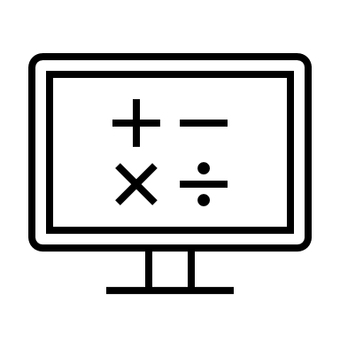

Psychometrics
Personality
Psychometrics are tests used to measure clearly defined psychological attributes
Ability
Typically use numerical or category scoring systems to describes individual differences
Notes:
Objective and standardised​
​
An assessment of a psychological attribute, typically scored using a numerical scale or category system​
​
Psycho= mind​
Metric= measure​

Slide 13
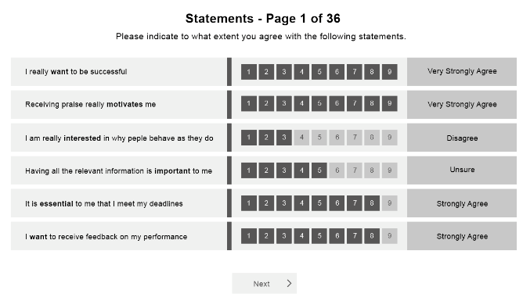
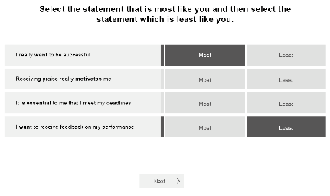
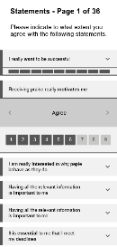
‘Will Do’ Assessments of Typical Performance
Include self-report questionnaires without time limits
‘Right’ and ‘wrong’ can vary depending on context
Wave Professional Styles example:
Notes:
2 buckets
Typical – normal day – how will you typically perform
ASK: other examples?
Interest inventories, personality questionnaires, motivational tests, attitude, 360
Has anyone done anything like this?

Slide 14
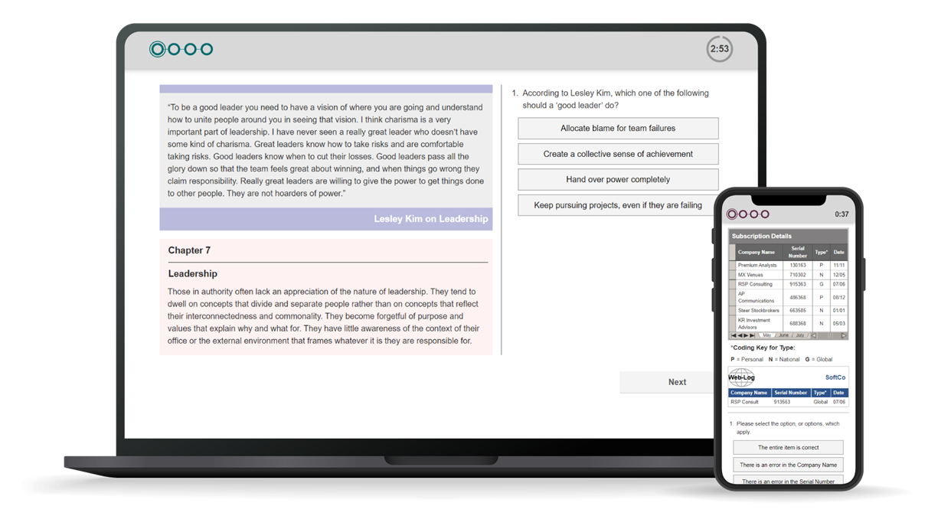
‘Can Do’ Ability Tests of Maximum Performance
Verbal Analysis Aptitude example
Include ability tests of aptitude, IQ and attainment:
      Aptitude: predict what someone will be able to learn or do in the future, e.g. Saville Assessment tests
      IQ: current level of intellect/cognitive ability, e.g. Wechsler Adult Intelligence Scale
      Attainment: measure current level of knowledge understanding or skill, e.g. driving test
Often with strict time limits
Clear right or wrong answers
Notes:
Can do – what is the maximum you can do in these circumstances?
No subject knowledge, underlying skill
Weckler
‘to what extent can they do something in the future’
Ask: how did everyone get on with practice qs

Slide 15
Key Points of Aptitude Testing
Benchmarks against external group​
A strong predictor of work performance​
Measures lots of different types of ability​
Efficient online assessment​
Fair and consistent treatment of candidates​
Supplements other sources of information​
Sophisticated question banking to protect the security of the content​
Notes:
Saville Assessment aptitude tests adhere to all of the above
Question/item banking is used to increase security of the test content
This means that candidates won’t all see the same questions and that those questions will be presenting in varying orders to prevent cheating

Slide 16
Module 2
Job Analysis

Slide 17
Job Analysis
Job analysis is a multi-method approach that is used for different purposes including:
      Defining role profiles/job descriptions/person specifications
      Job sizing for pay grading
      Developing a framework of criteria for assessment e.g. skills potential
In assessment, good job analysis focuses on things that can be defined clearly and measured well
Notes:
Job analysis is the first thing you should do when starting an assessment process
It is critical for you to understand ‘what good looks like’ in a given role to be able to assess for those skill potential areas

Slide 18
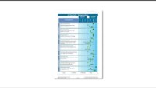
Job Analysis

Slide 19
Common Methods of Job Analysis
Traditionally, job analysis was very time consuming and involved methods to collect information from multiple sources
Structured interviews
Job content reviews
      Job holders e.g. critical incident identification
      Line managers e.g. repertory grid comparisons
      Visionary interviews can be conducted in a structured way with a mixture of stakeholders to establish the key requirements for a role going forwards
      Diaries
      Observing the job
      Doing the job
      Task/job analysis questionnaires
      Validation research
Validation research
      Large samples of job holders or applicants
      Establishing statistical links between test scores and job performance
Notes:
These are a few examples of methods that are commonly used in other organizations
Structured interviews provide perspectives and allows an insight into specific circumstances. Often situations with a particularly positive or negative outcome are evaluated to understand the behaviors or skills that contributed to the particular outcome.
Critical incident identification is where job holders discuss specific difficulties they face in role, how they responded and what outcome was achieved.
Repertory grid comparisons are where a manager would the compare the behaviors and skillsets of the employees in their team to identify what helps a person perform well in the role.
Job content reviews are useful when the job remains similar or the same each day
Validation research is the gold standard and allows us to statistically analyze how predictive certain behavioral competencies or skills are of workplace performance.

Slide 20
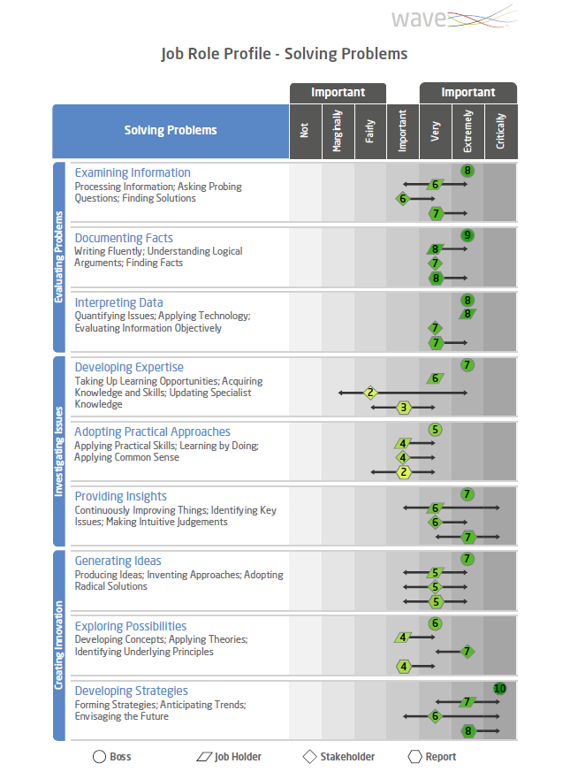
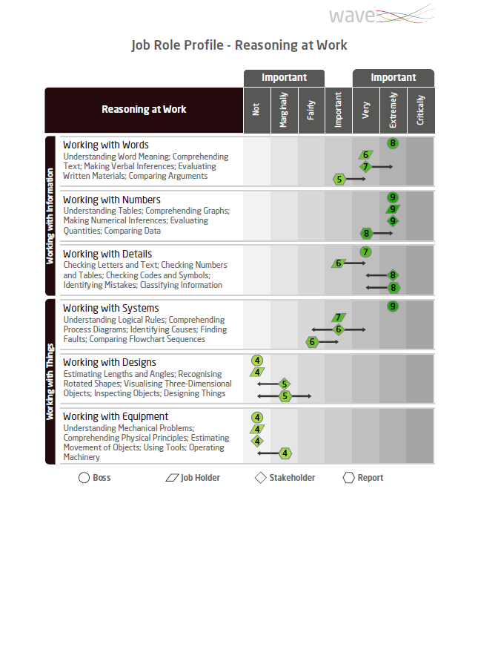
Wave Job Profiler
Online tool (15 minutes)
Survey different stakeholders
7-point ‘Importance’ rating
Can add comments
Notes:
One tool that can be used to support job analysis is our Job Profiler questionnaire
This can be sent to multiple stakeholder categories to gain their insight on how important various competencies are to the role
It is particularly useful when there is a client who would like to gain the opinions of multiple people based in different locations

Slide 21
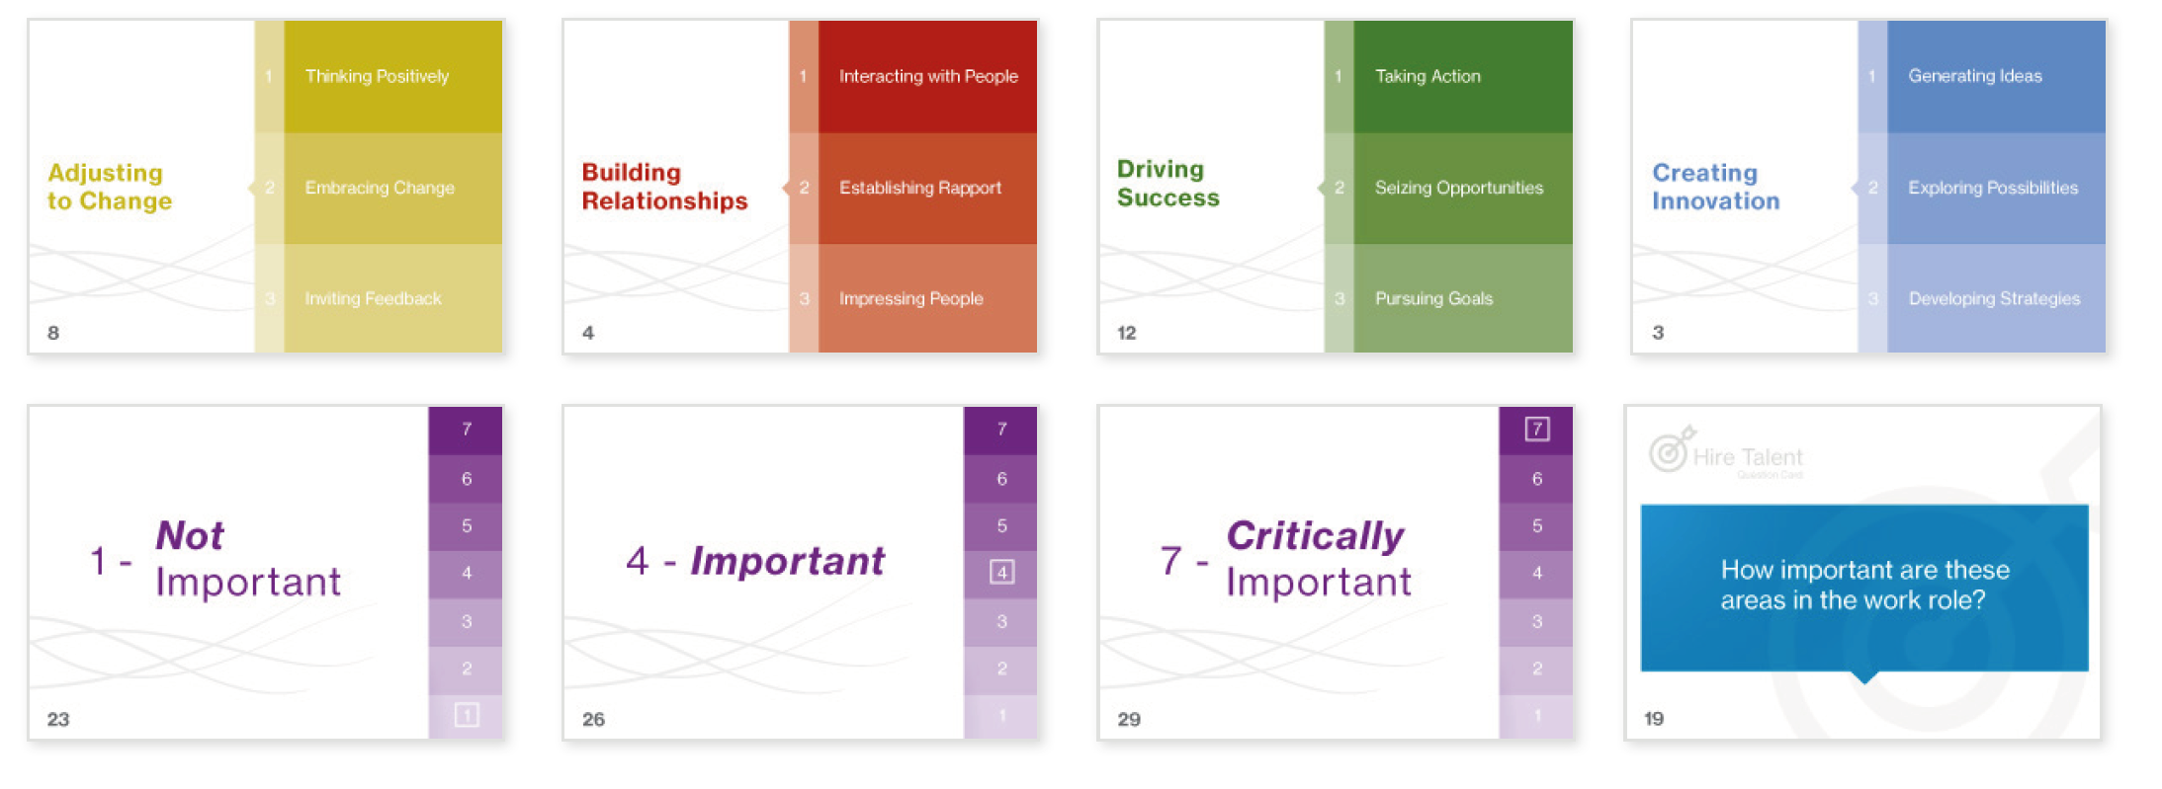
Wave Card Deck
Notes:
Alternatively, we do have card decks available to be purchased
These can be used to run in person job analysis focus groups

Slide 22
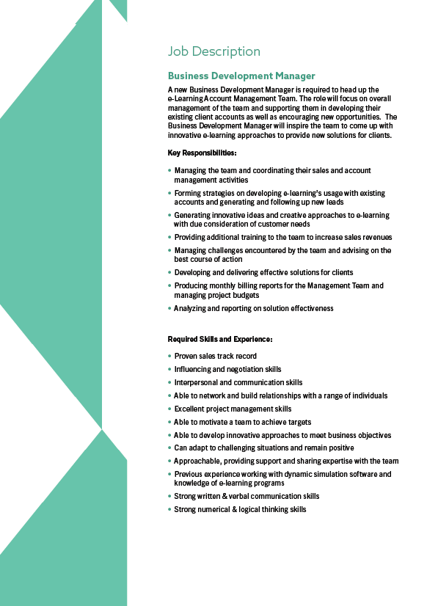
Case Study: Job Analysis
Workbook page 14-18
Card Sort
  Review the job description on page 17 and 18 of Workbook
  Use the Wave card deck on pages 15 and 16 to identify up to eight key skills potential areas (five behaviors and three abilities)
  List your key skills potential areas in your workbook on page 14

Slide 23
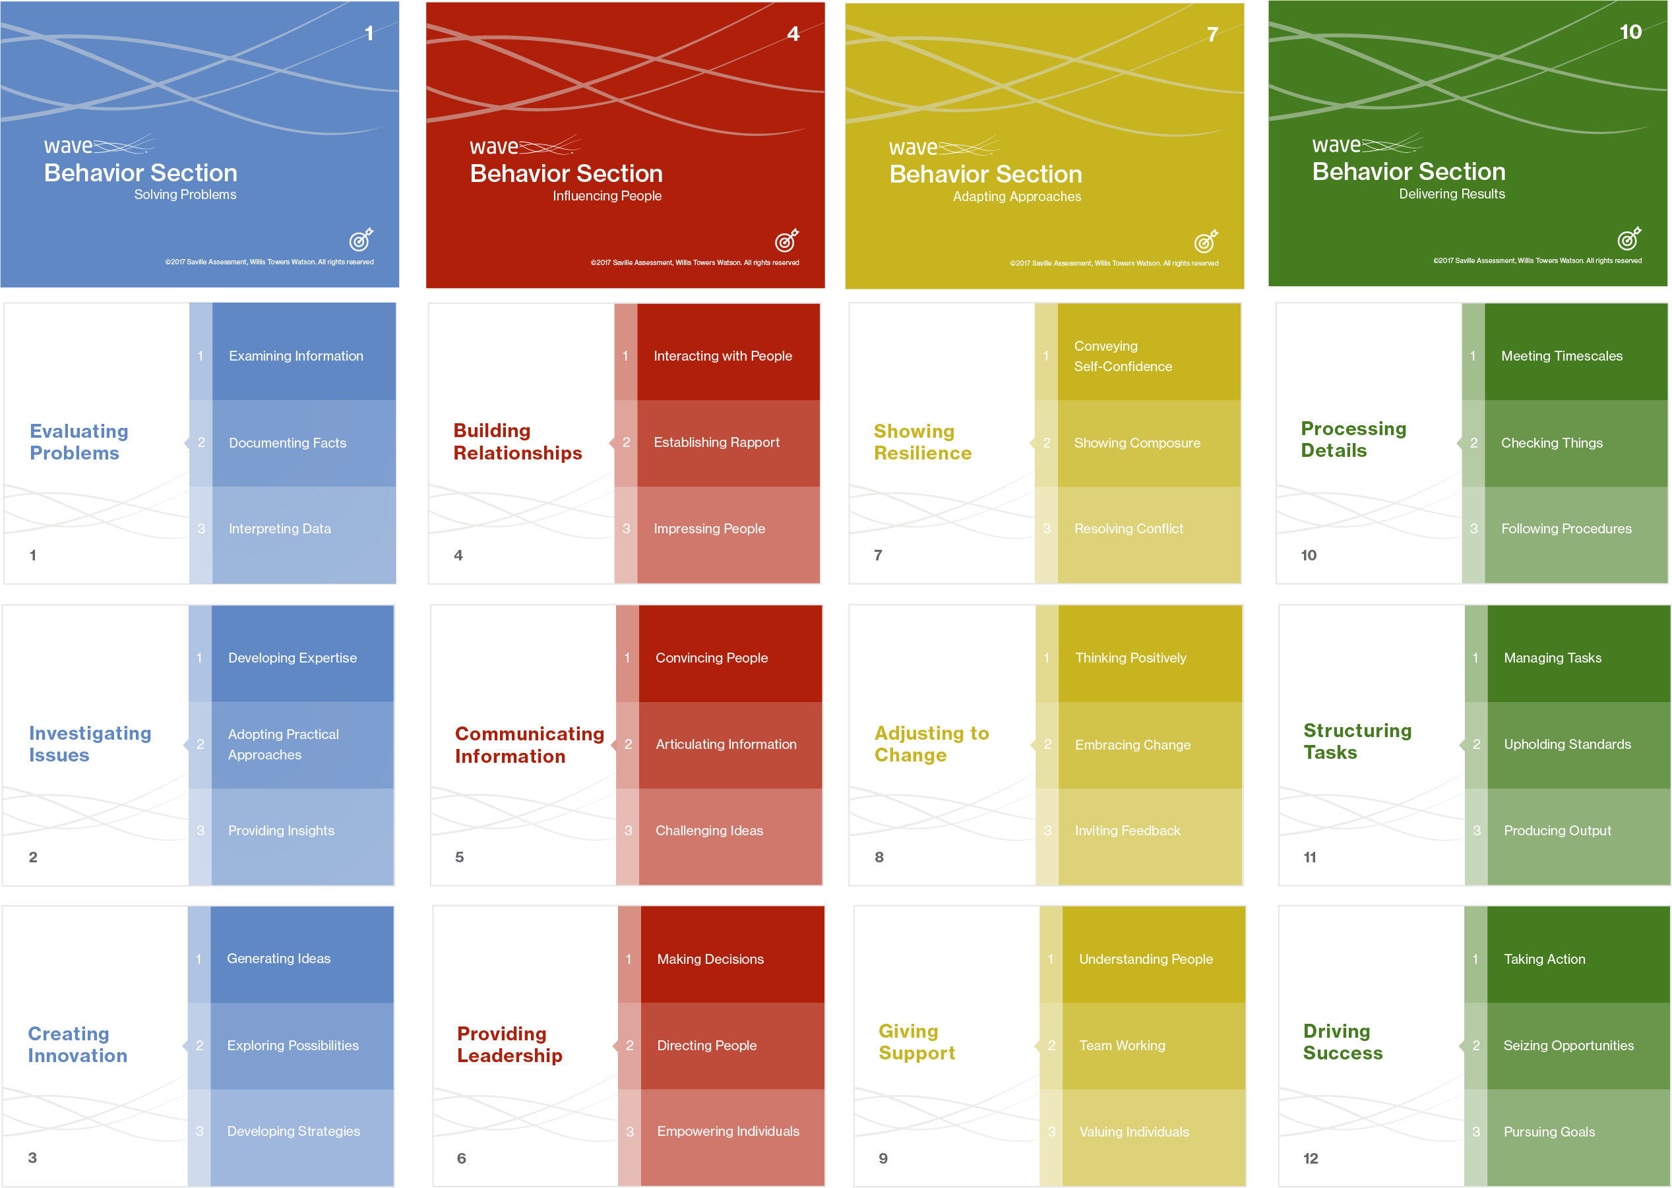
Case Study: Job Analysis
‘Hire’ Card Deck – Behavioural Sections
Notes:
Encourage trainees to discuss these 12 Wave Sections in relation to the role
The goal is to choose 4 Sections as critically important, these do not need to be split across the 4 Clusters/colors
All Sections are positively worded, making them all sound desirable, try to think of which behaviors a person could not do the job without
Creating Innovation – Generating innovative ideas and creative approaches to e-learning with due consideration of customer needs / Able to develop innovative approaches to meet business objectives
Providing Leadership - Managing the team and coordinating their sales and account management activities
Driving Success - Able to motivate a team to achieve targets/ Pursuing goals etc
Building Relationships - Able to network and build relationships with a range of individuals
Adjusting to change - Resolving Conflict - Managing challenges encountered by the team and advising on the best course of action

Slide 24
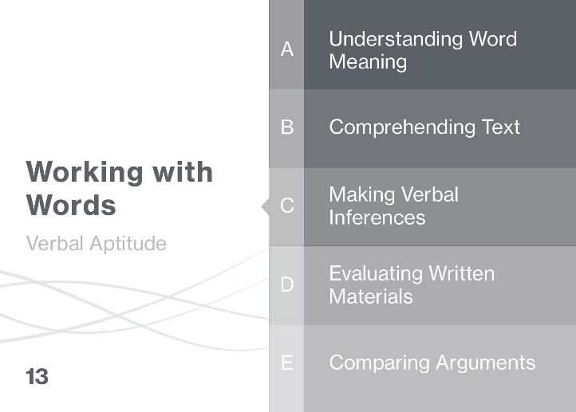
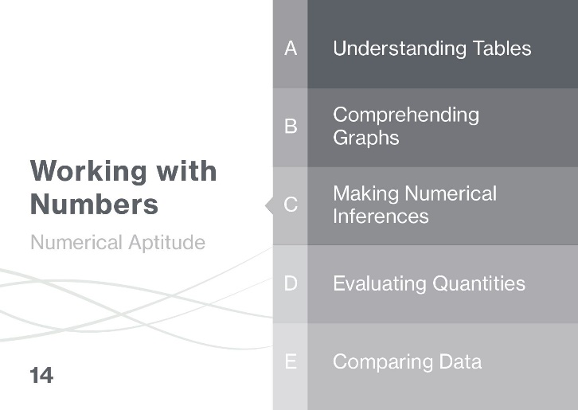
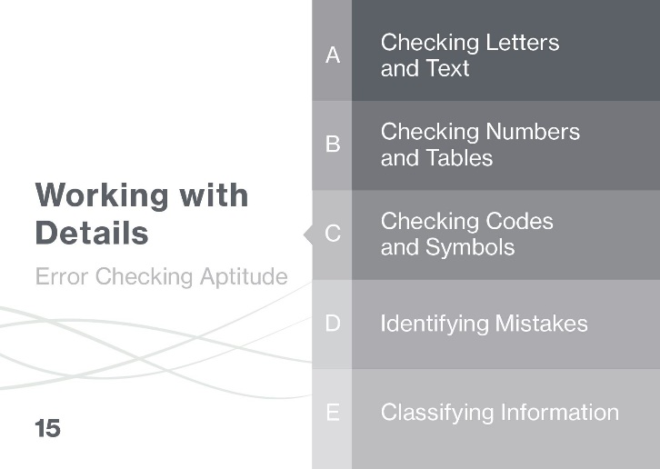
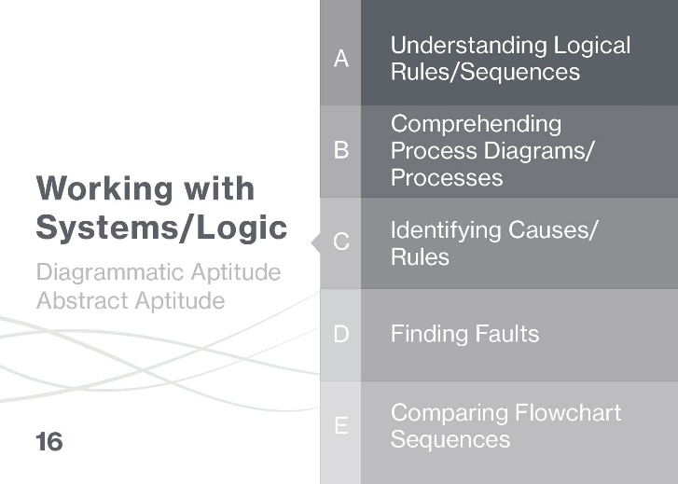
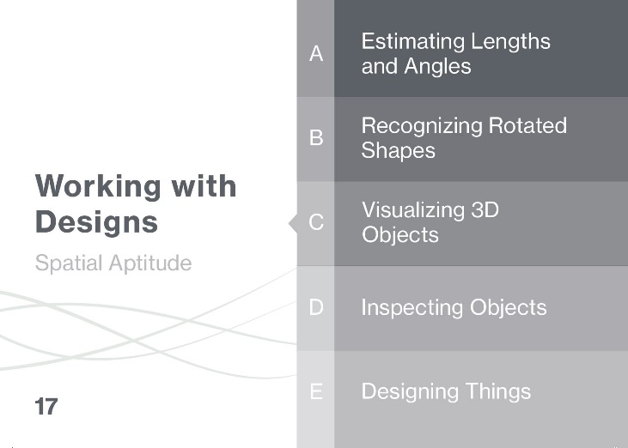
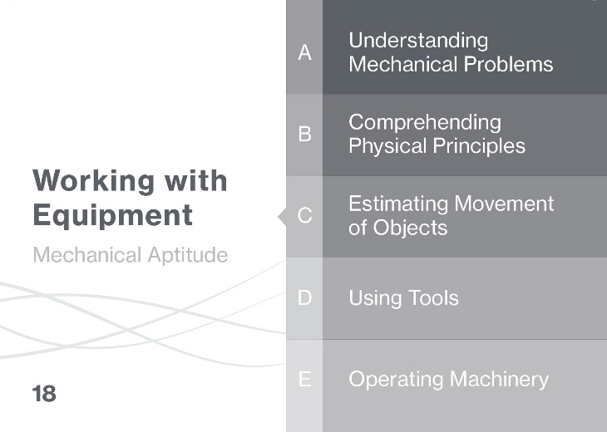
Case Study: Job Analysis
‘Hire’ Card Deck – Ability Sections
Working with Information
Working with
Things
Notes:
Encourage trainees to discuss and agree on 3 ability areas for the role
Working with numbers - Monthly reports –
Working with Words
Working with Systems/Logic
• Strong written & verbal communication skills
• Strong numerical & logical thinking skills

Slide 26
Module 3
Assessment Choice and Administration

Slide 27
Considerations for Choosing Assessments
Early considerations
Other considerations (to be discussed later)
Do the test yourself
    Does it look good?
    Does it make sense?
    Is the content relevant to the role?
    Does the content appear fair and inoffensive?
Is it psychometrically sound?
How much does it cost in total?
What are the administration practicalities? (screening online, supervised final stage, number of candidates, etc.)
Notes:
Practice versions of the assessments can be found on the Saville Assessment website on the ‘candidate preparation’ page

Slide 28
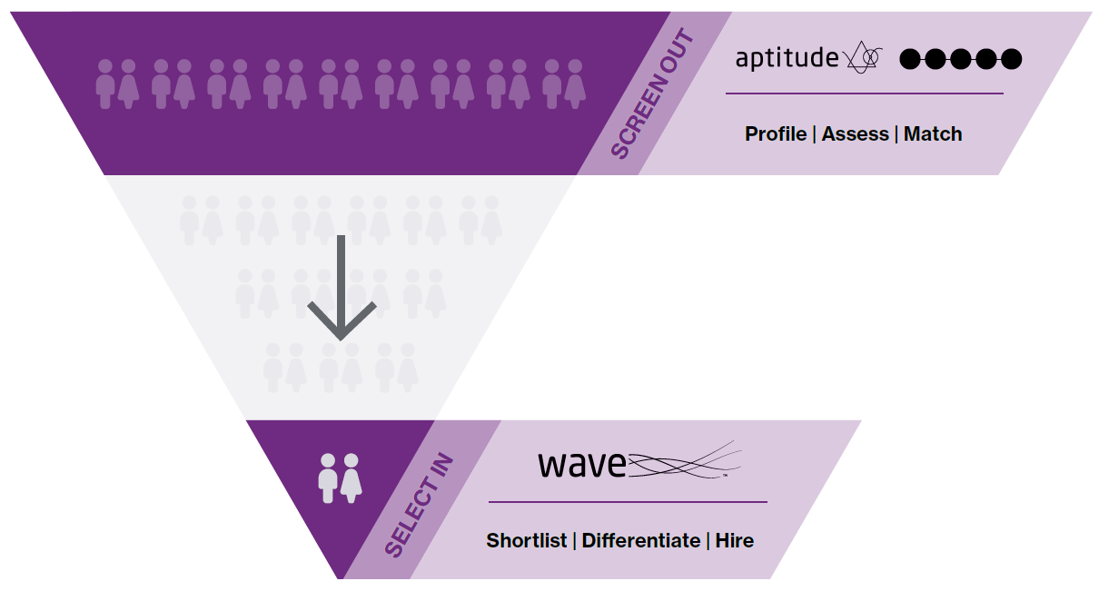



Screen Out, Select In

Slide 29
Saville Assessment Aptitude tests​
Analysis Range
Target Group | Abilities Assessed | Norms Available | Test Options
Directors Managers Professionals Graduates Management Trainees | Verbal (V) Numerical (N) Diagrammatic (D) Abstract (A) Recall (R) | Senior Managers & Executives Professionals & Managers Graduates Individual Contributors Mixed Occupational | Online Unsupervised Combined Tests Swift Executive Aptitude (V, N, A) Swift Analysis Aptitude (V, N, D) Swift Analysis Verbal & Numerical (V, N) Swift Global (R, N, A) Single Tests

Slide 30
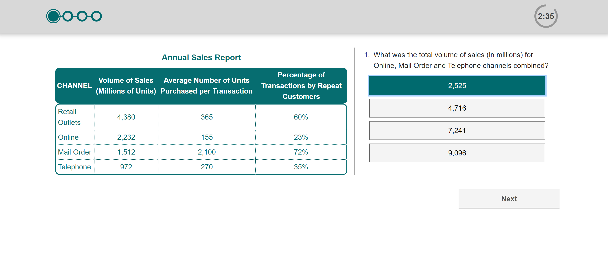
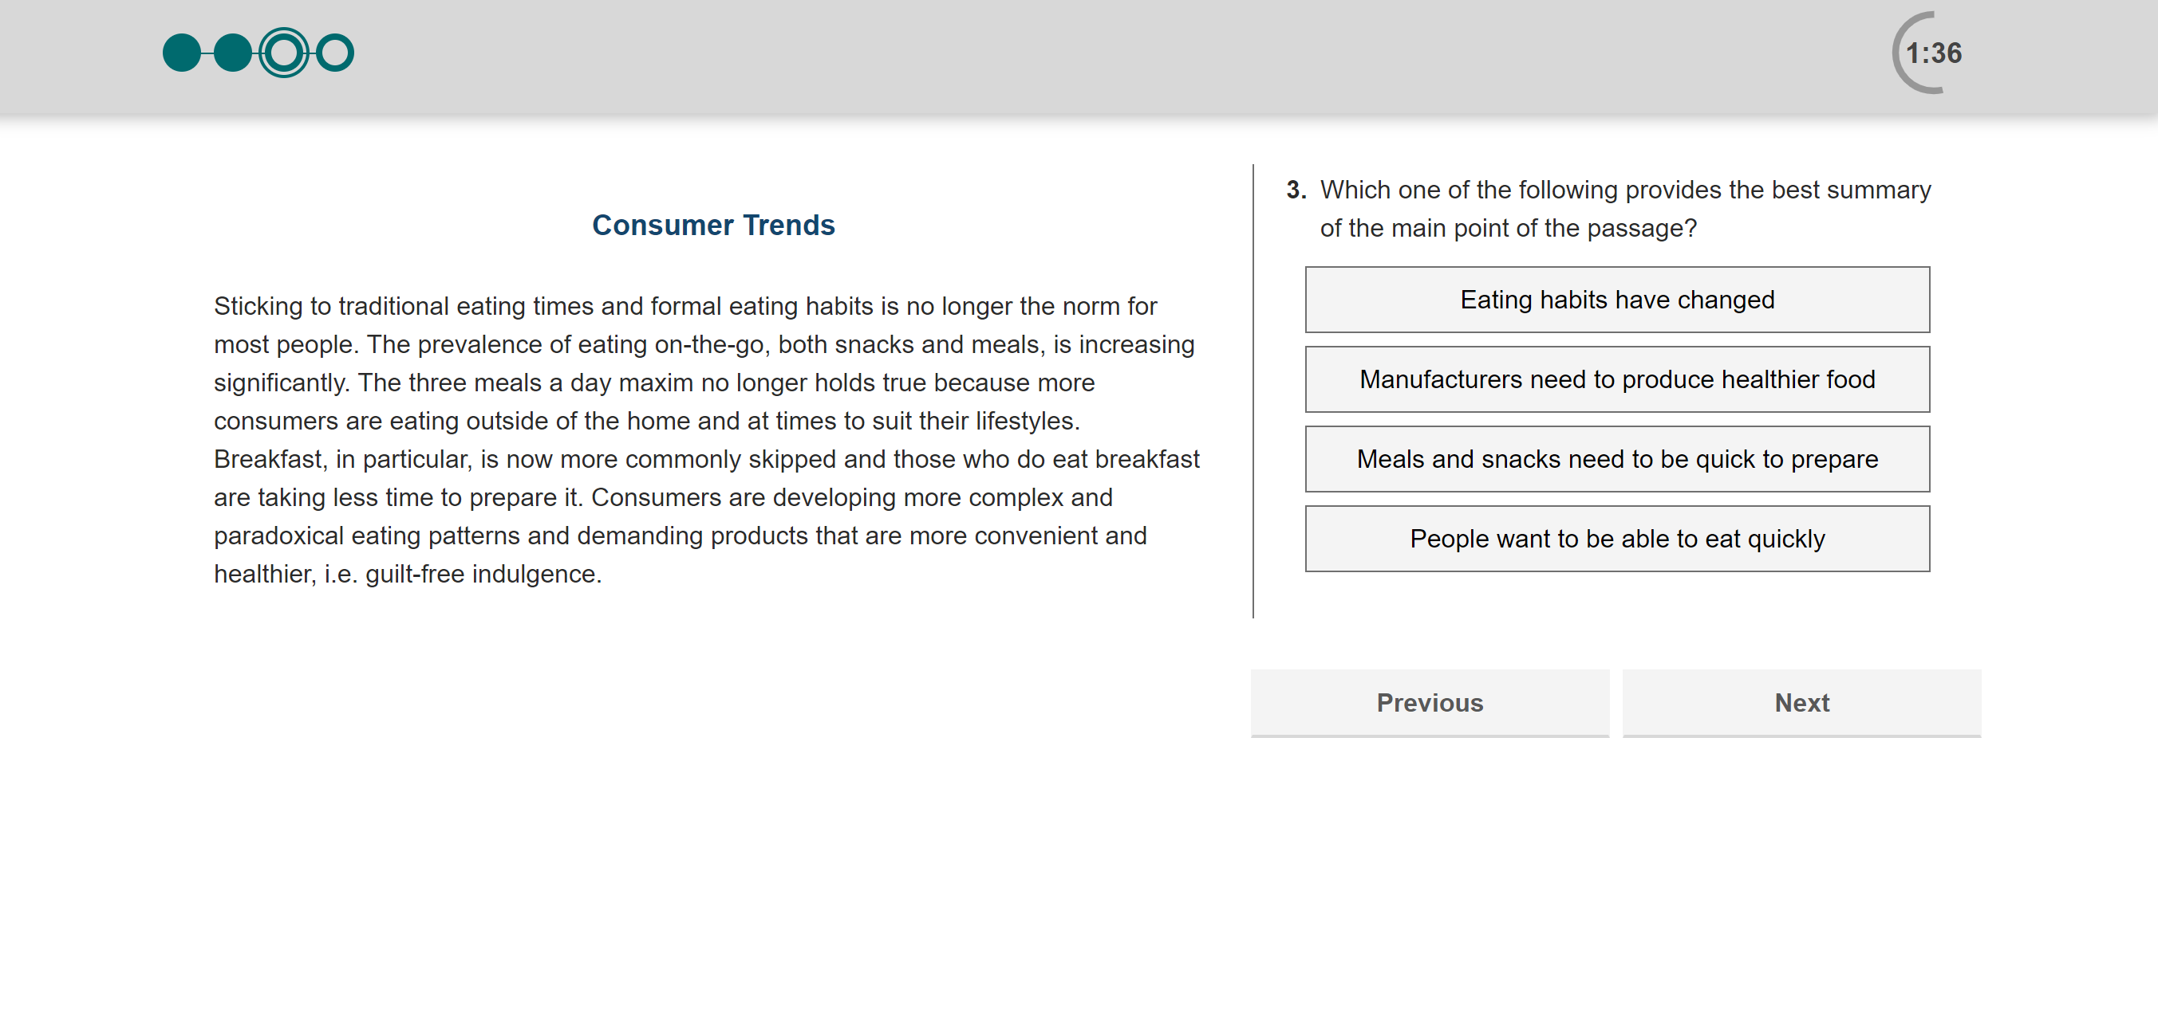
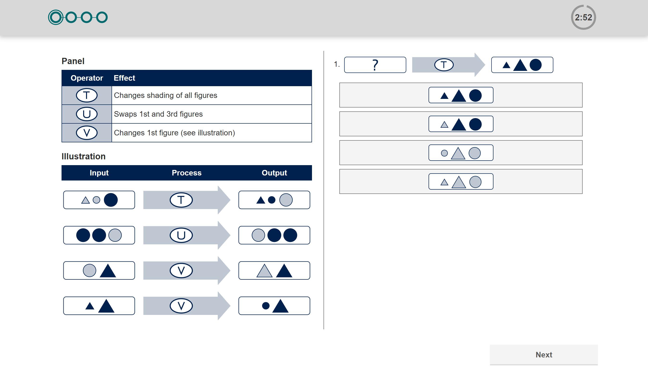
Analysis Aptitudes
Numerical
Swift or single aptitudes
Verbal
Diagrammatic
30
Notes:
Each of these can be assessed using a single full-length assessment (24-minutes) or as a Swift combination assessment:
Swift Analysis Aptitude (Verbal, Numerical, Diagrammatic) – 18-minutes
Swift Analysis Verbal & Numerical (Verbal, Numerical) – 24-minutes

Slide 31
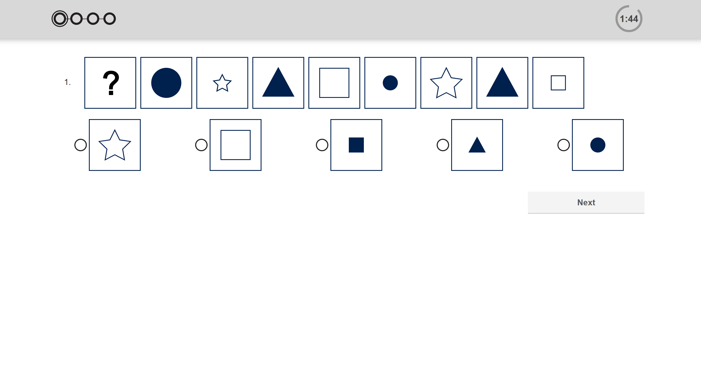
Abstract Reasoning Aptitude
Swift Executive or single aptitude
Notes:
Abstract Reasoning can be assessed using a single full-length assessment (16-minutes) or as a Swift combination assessment:
Swift Executive Aptitude (Verbal, Numerical, Abstract) – 18-minutes

Slide 32
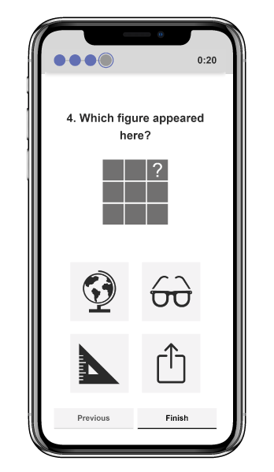
Swift Global Aptitude
Swift Combination
Mobile-first, interactive, measure of the capacity to flexibly problem solve independent of previous knowledge & apply learning in new environments at work.
The 12-minute combination test measures 3 areas:
Recall – assesses the ability to correctly remember figures and their position in a grid of cards.
Numbers – assesses the ability to identify patterns in a series of numbers.
Abstract – assesses the ability to identify patterns in a series of shapes and symbols.
Notes:
Abstract Reasoning can be assessed using a single full-length assessment (16-minutes) or as a Swift combination assessment:
Swift Executive Aptitude (Verbal, Numerical, Abstract) – 18-minutes

Slide 33
Saville Assessment Aptitude tests​
Comprehension Range
Target Group | Abilities Assessed | Norms Available | Test Options
Administrative Roles Customer Service Roles Operational Roles Commercial Roles | Verbal (V) Numerical (N) Error Checking (EC) | Mixed Occupational Group Individual Contributors Apprentices Foundation (International Only) | Online Unsupervised Combined Tests Swift Comprehension Aptitude (V, N, EC) Swift Comprehension Verbal & Numerical (V, N) Single Tests

Slide 34
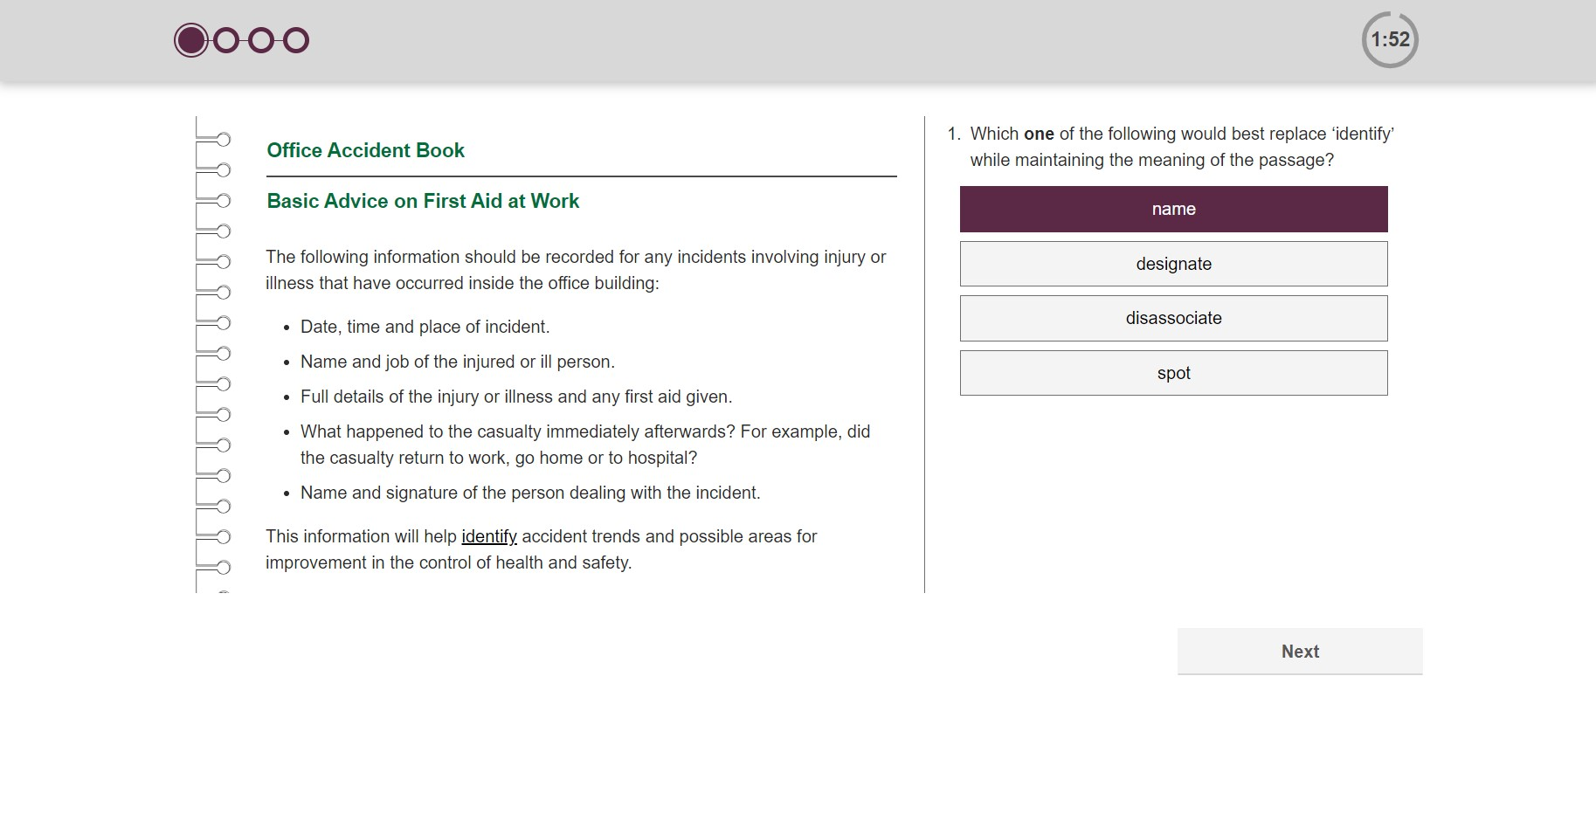
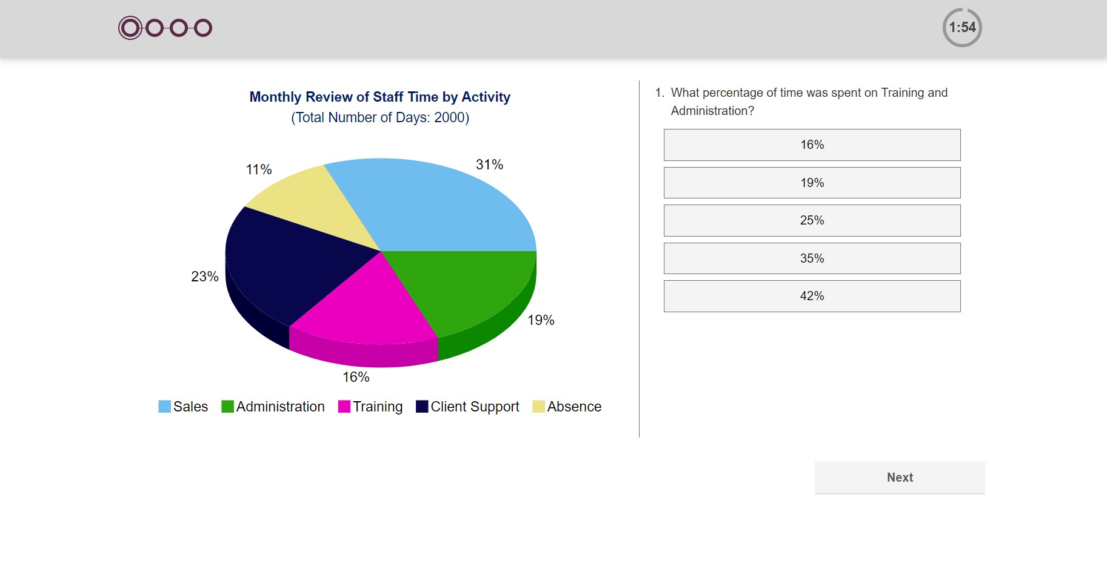
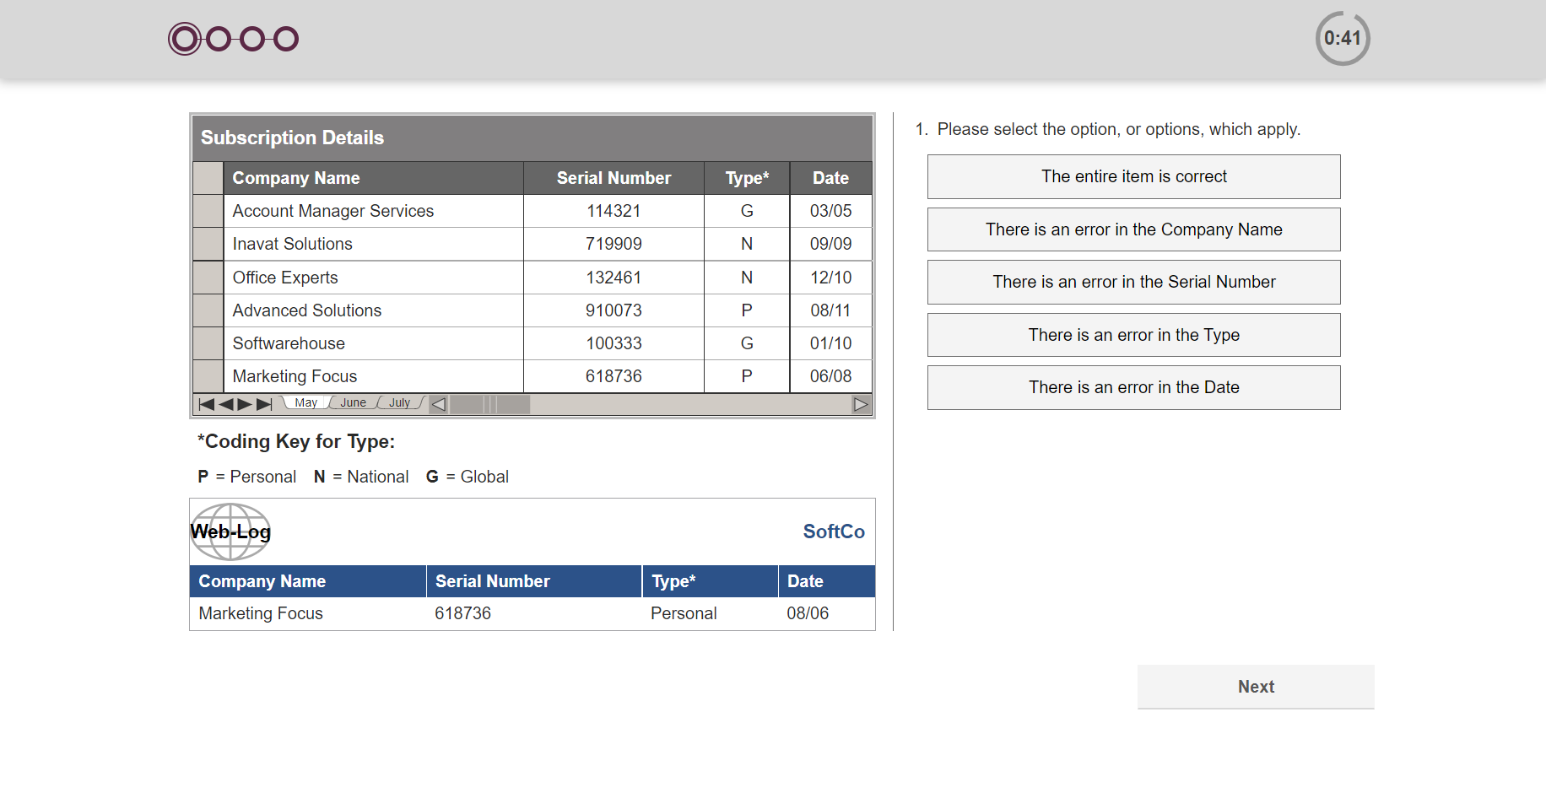
Comprehension Aptitudes
Swift or single aptitudes
Verbal
Numerical
Error Checking
34
Notes:
Each of these can be assessed using a single full-length assessment (16-minutes for Verbal or Numerical and 6-minutes for Error Checking) or as a Swift combination assessment:
Swift Comprehension Aptitude (Verbal, Numerical, Error Checking) – 9.5-minutes
Swift Comprehension Verbal & Numerical (Verbal, Numerical) – 16-minutes

Slide 35
Saville Assessment Aptitude tests​
Technical Range
Target Group | Abilities Assessed | Norms Available | Test Options
Production Roles Construction Roles Engineering Roles Scientific Roles | Spatial Mechanical Diagrammatic | Mixed Occupational Group Apprentices | Online Unsupervised Swift Combination and Single
Swift Apprentice Ability
Target Group | Abilities Assessed | Norms Available | Test Options
Apprentices | Verbal Numerical Error Checking Spatial Mechanical Diagrammatic | Apprentices | Online Unsupervised Swift Apprentice Aptitude

Slide 36
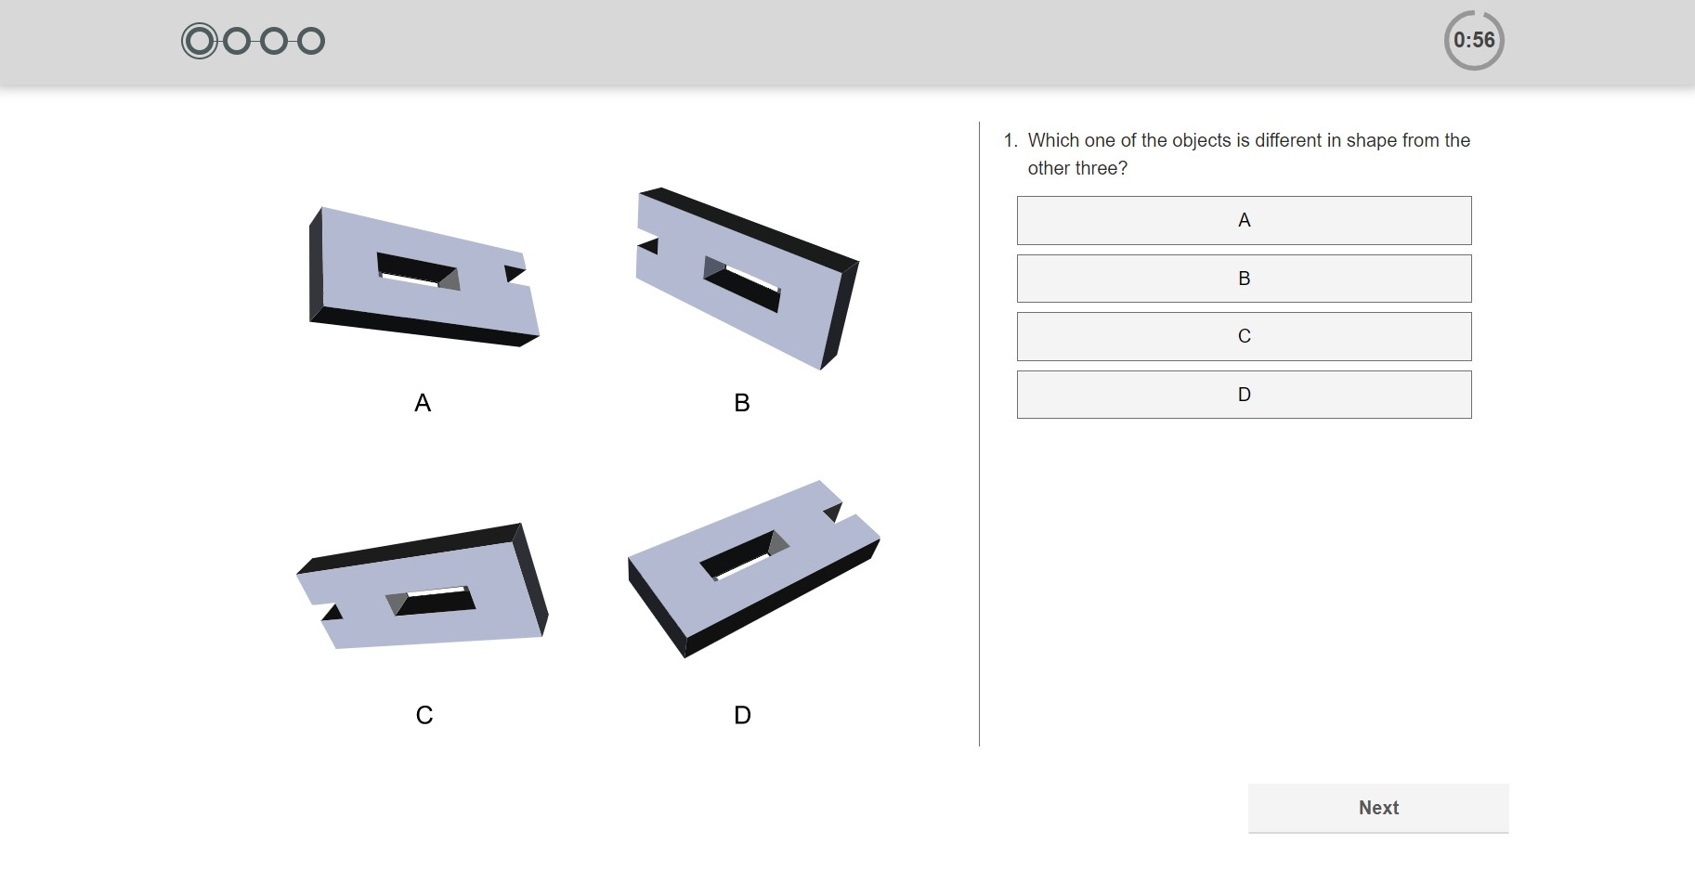
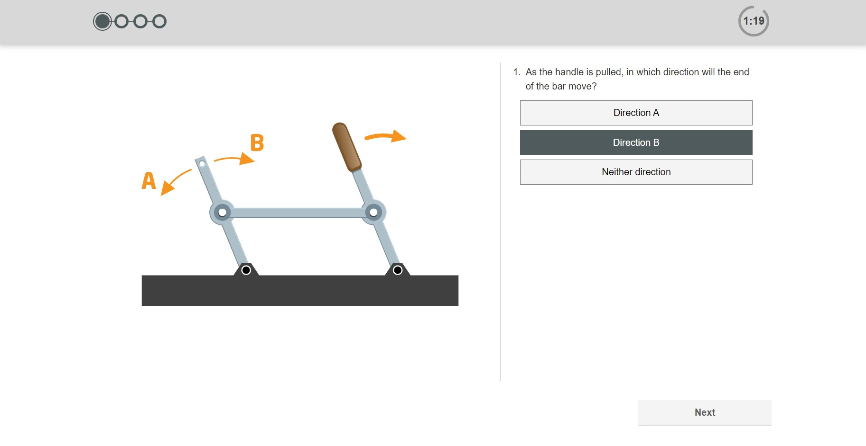
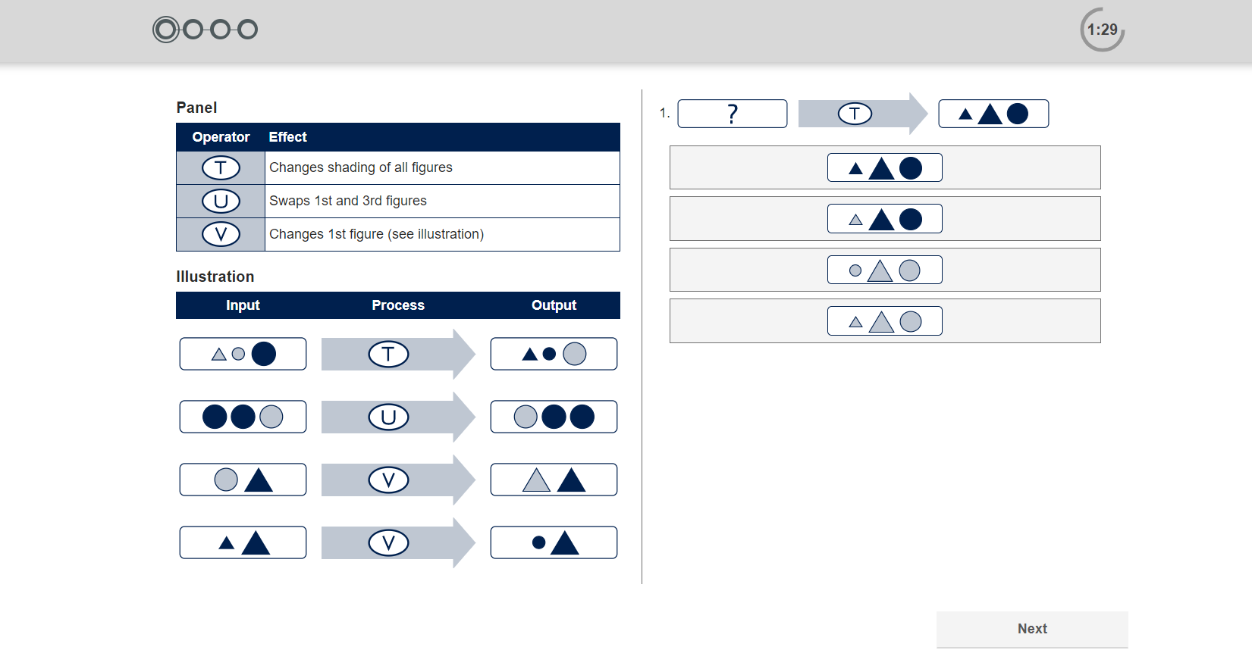
Technical Aptitudes
Swift or single aptitudes
Spatial
Mechanical
Diagrammatic
36
Notes:
Each of these can be assessed using a single full-length assessment (8, 12, 16-minutes respectively) or as a Swift combination assessment:
Swift Technical Aptitude (Spatial, Mechanical, Diagrammatic) – 10-minutes

Slide 37
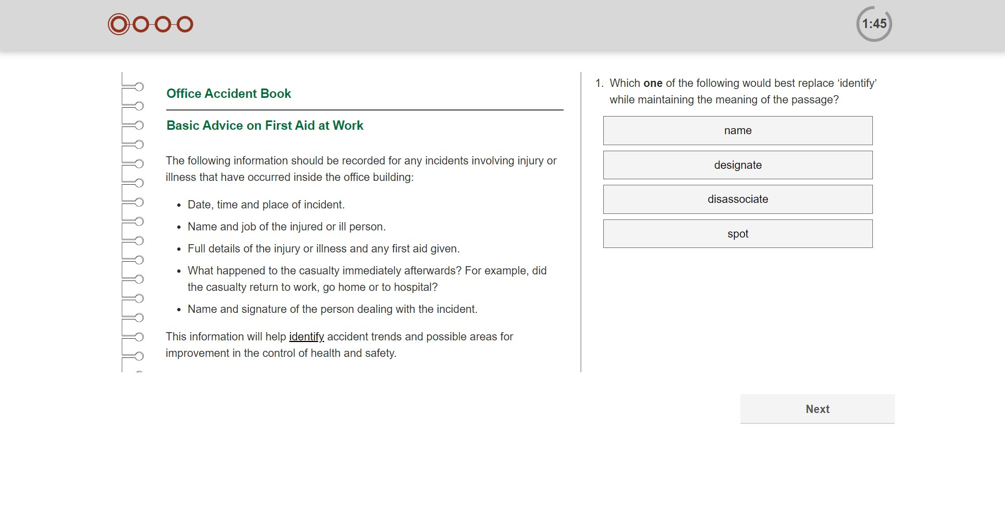
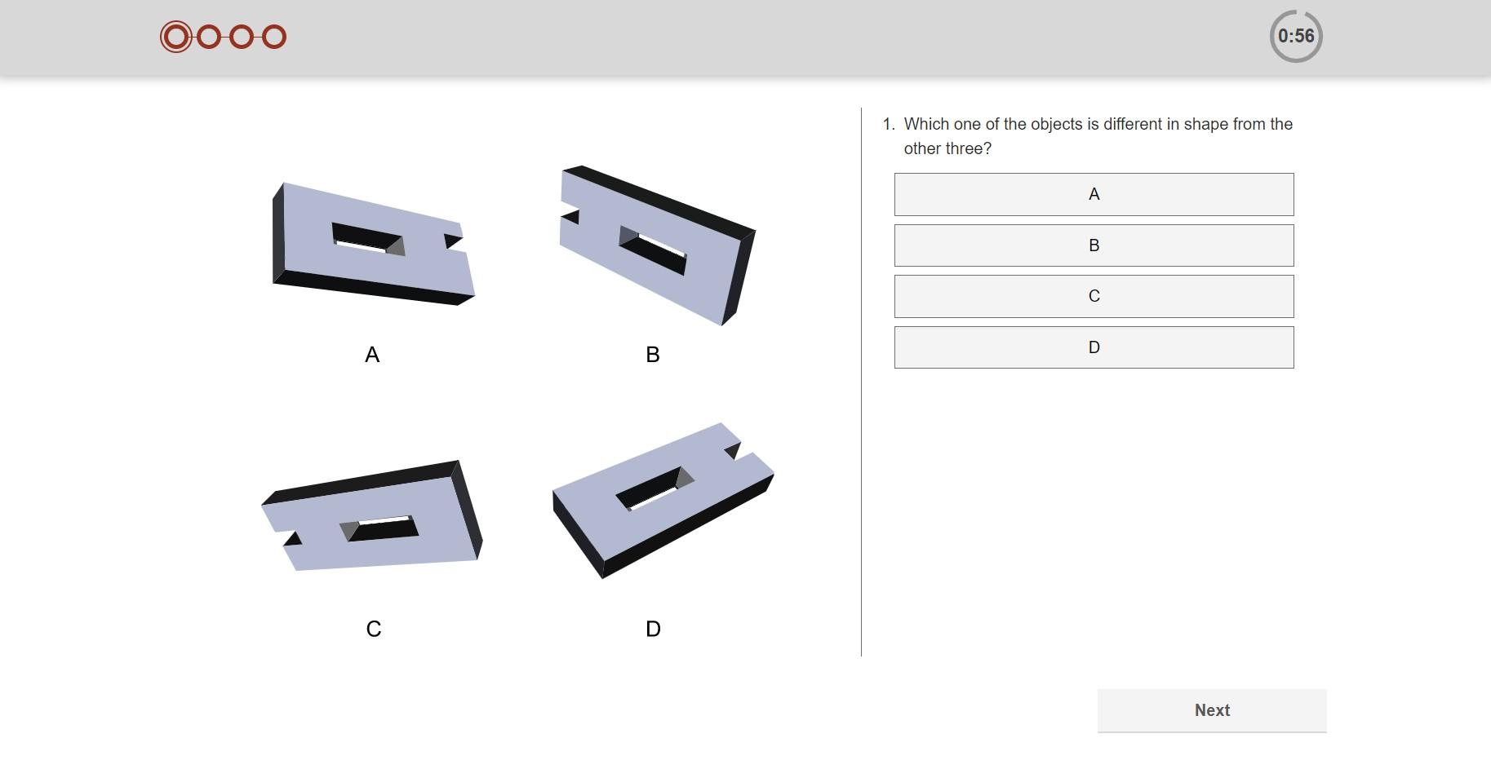

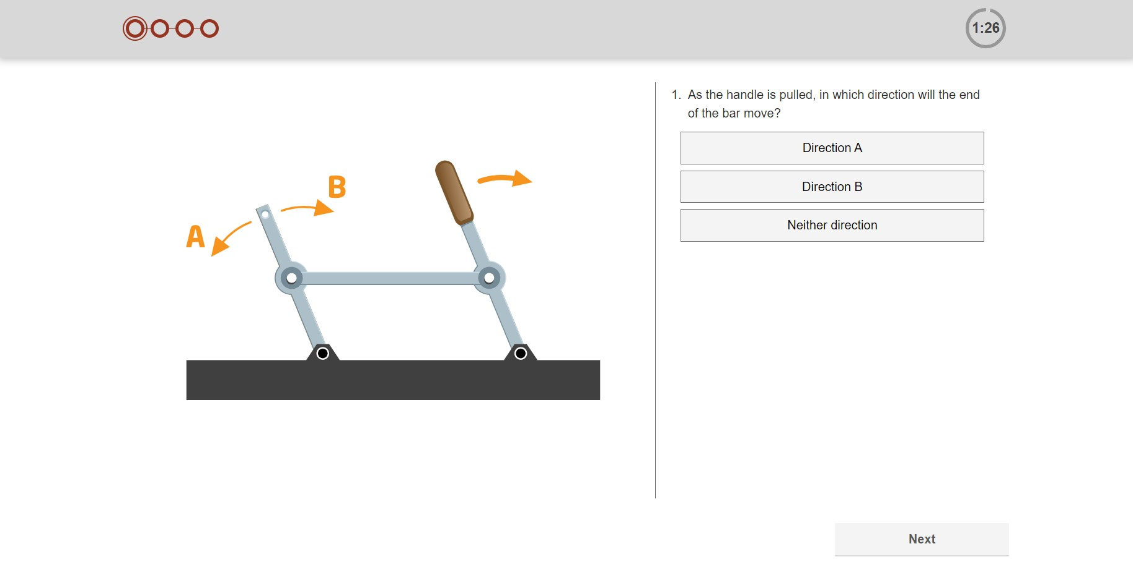

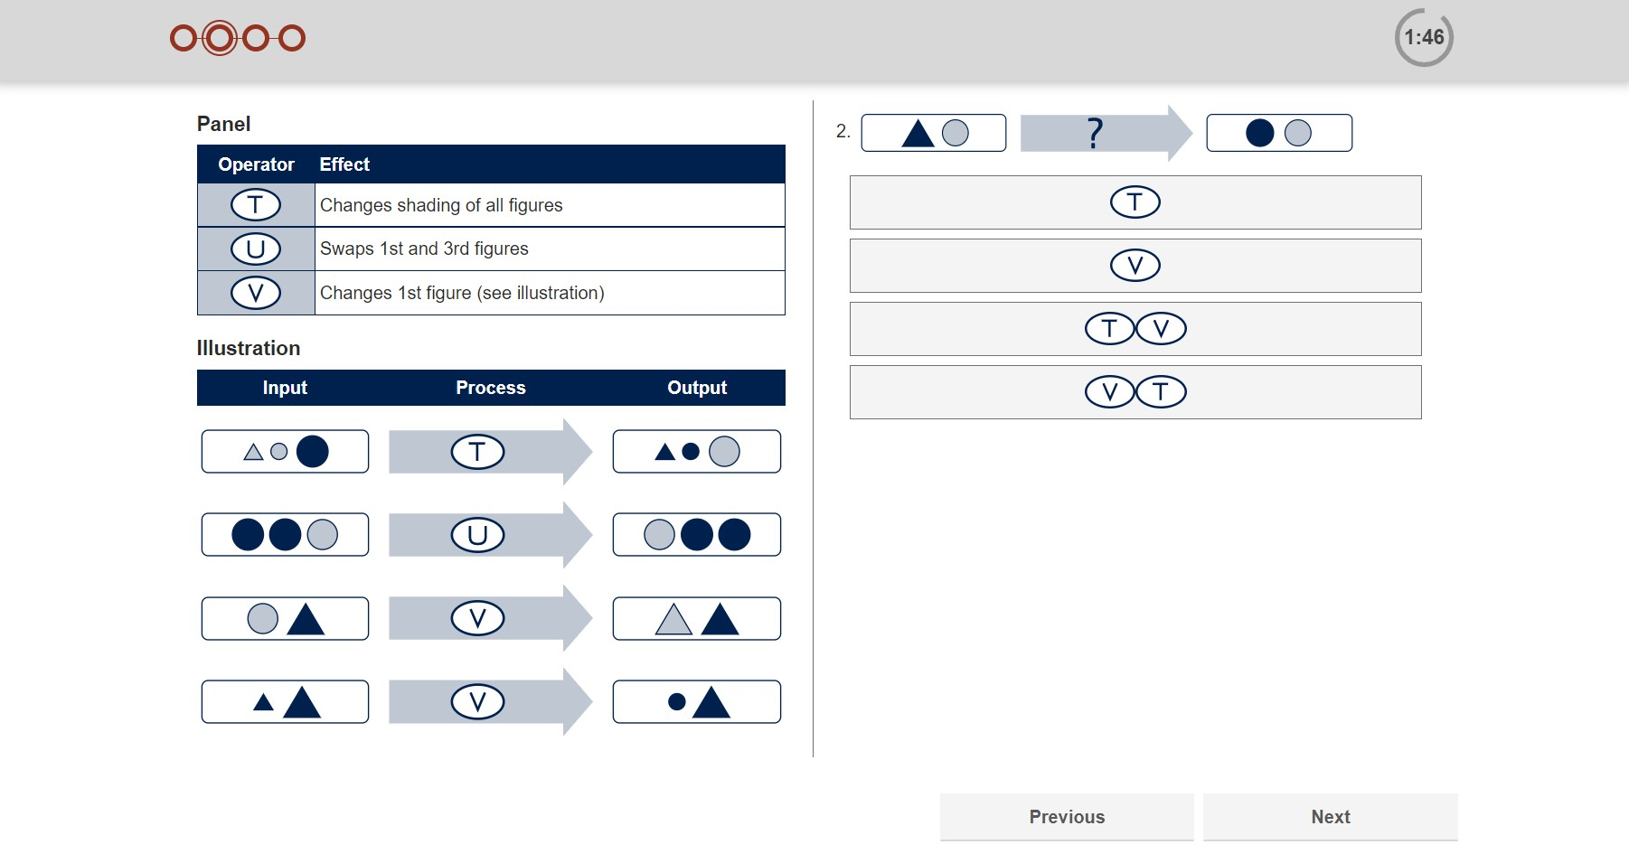
Swift Apprentice Aptitude
Spatial
Verbal
Numerical
Mechanical
Error Checking
Diagrammatic
37
Notes:
Each of these can be assessed using a single full-length assessment (8, 12, 16-minutes respectively) or as a Swift combination assessment:
Swift Technical Aptitude (Spatial, Mechanical, Diagrammatic) – 10-minutes

Slide 38
Why use Cognitive Ability tests?
Hire
Build
Lead
Aptitude tests are mostly used for recruitment purposes, either in screening or selection.
Tests are used less frequently for individual development, although career guidance and planning tools often contain an aptitude component.
Despite many leaders’ avoidance of testing, cognitive ability has been shown to be especially predictive of performance at senior levels.
Notes:
Cognitive ability tests are the most valid predictor of workplace performance across these applications and across job levels

Slide 39



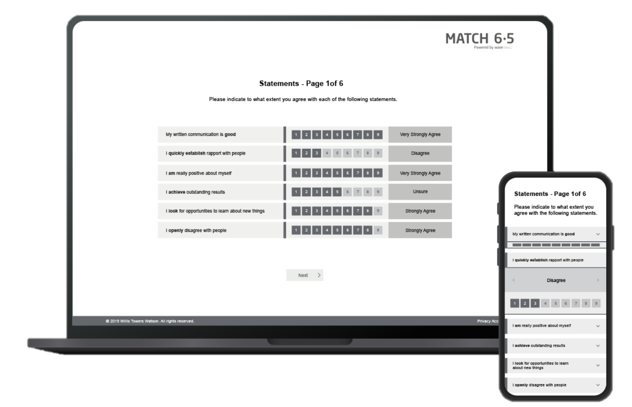


Behavioral Questionnaires
Screening Questionnaires
Underpinned by the highly-researched Wave model
In-depth Styles assessments to explore working styles including exploring situational differences and discrepancies between motivation and talent
Short behavioral screening assessments that can provide one fit score for rapid decision making in screening
Mobile-first responsive design for an improved candidate experience
Professional Styles
Focus Styles
Notes:
Both the Professional and Focus Styles questionnaires are in-depth assessments measuring an individual’s needs, motives, preferences and talents in critical work areas
Work Strengths and Match 6.5 are designed for screening candidates and provide a highly-valid output for quick decision making

Slide 40
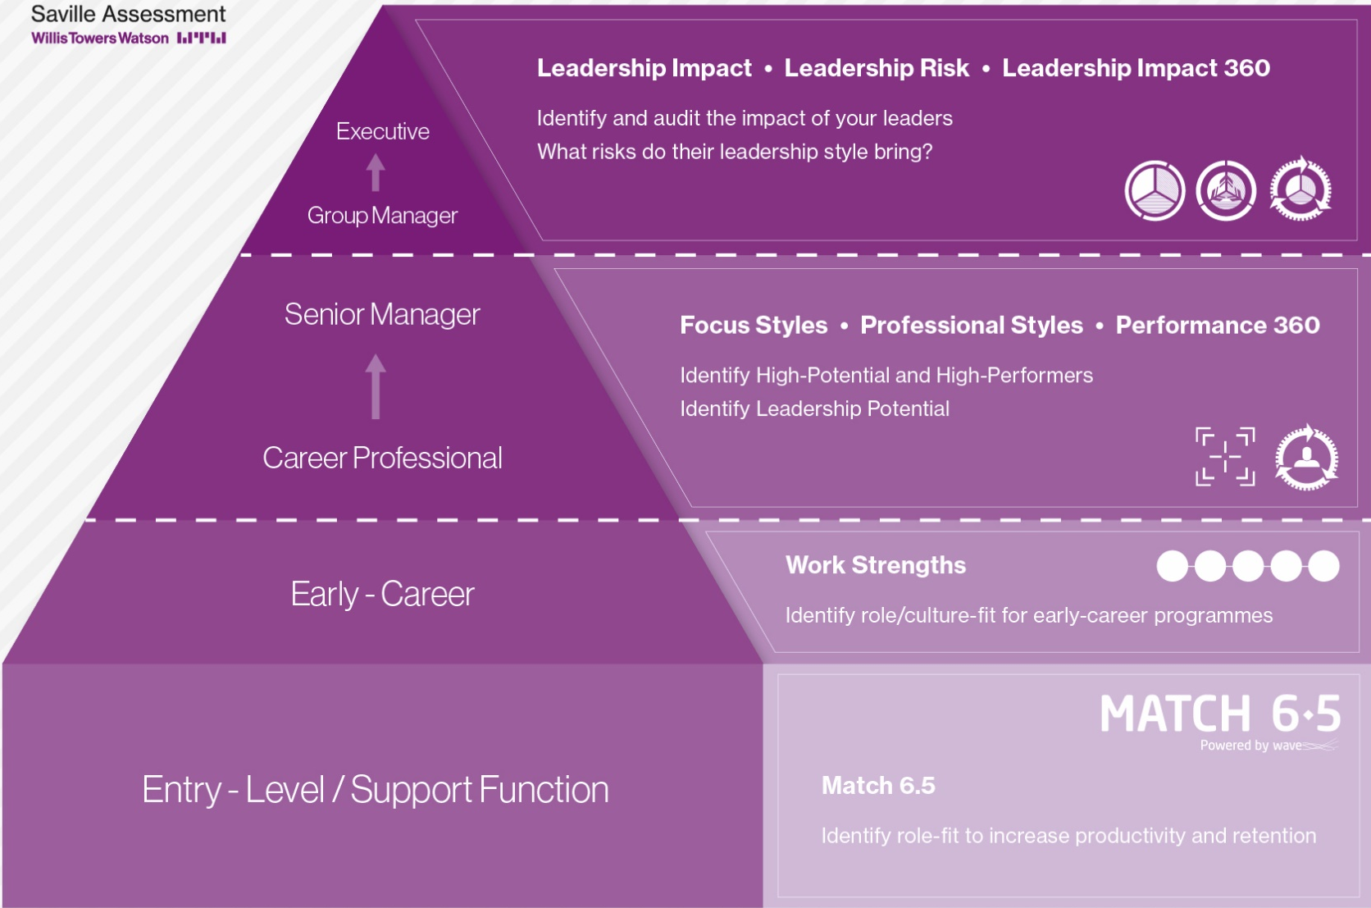
Job Levels
Work Strengths
Identify role/culture-fit for early-career programmes
Match 6.5
Identify role-fit to increase productivity and retention
Notes:
Recommend behavioral assessment tools by level

Slide 41
Workplace English
Traditionally, job analysis was very time consuming and involved methods to collect information from multiple sources
Assesses candidates’ ability to understand workplace English
      Secure and easily administered online in less than 20 minutes
Example question
I [?] review the situation tomorrow
Tests for five different industry sectors:
      Customer Service, Healthcare, Hospitality, Office, Operations
am
will
do
think
Each test comprises 33 items:
      24 industry-specific items
      Nine general workplace items

Slide 42
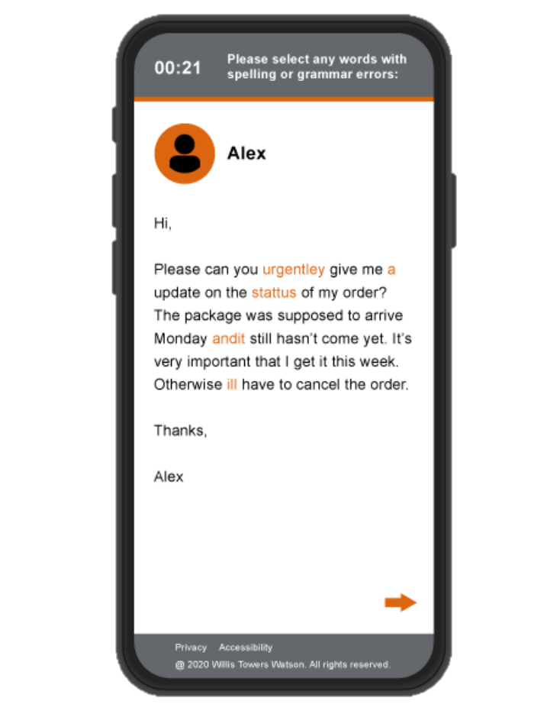
Customer Check
New online assessment identifying how well individuals will interact with customers and represent your brand on live web chats.
Highly-relevant assessment specifically designed to replicate typical customer contact.
Compatible with a range of devices, including laptops, tablets and mobiles.
Quick and engaging assessment with a 10-minute completion time.
Notes:
Each of these can be assessed using a single full-length assessment (16-minutes for Verbal or Numerical and 6-minutes for Error Checking) or as a Swift combination assessment:
Swift Comprehension Aptitude (Verbal, Numerical, Error Checking) – 9.5-minutes
Swift Comprehension Verbal & Numerical (Verbal, Numerical) – 16-minutes

Slide 43
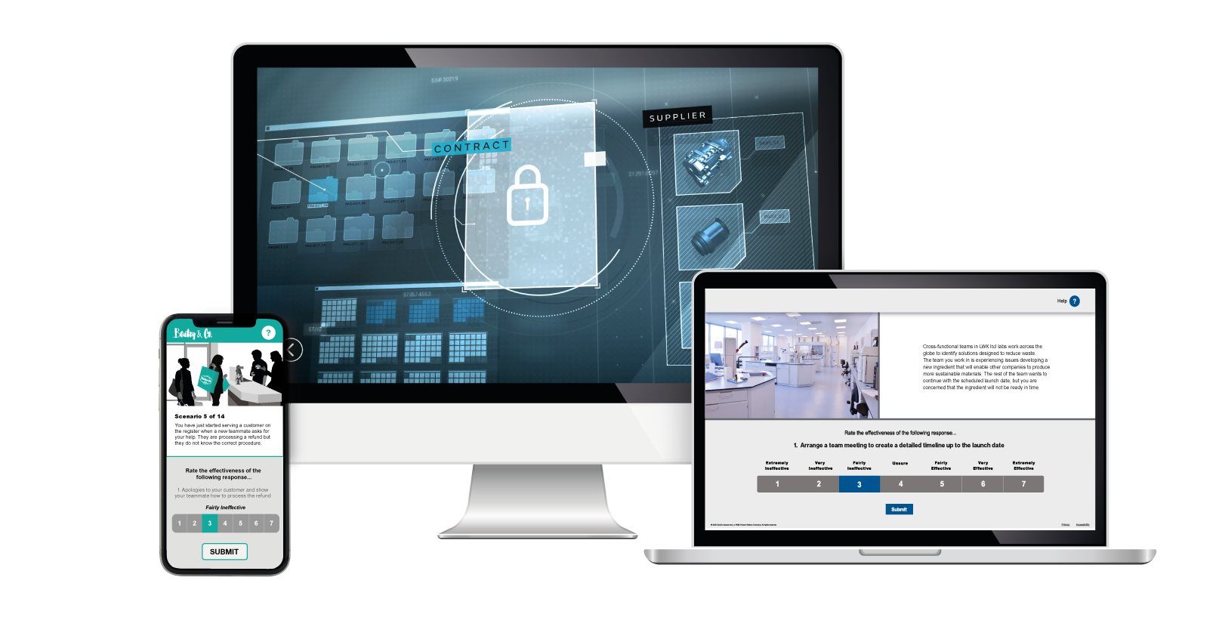
Situational Judgment tests
Notes:
Performance driven
Valid assessments – paired with aptitude
Enables behavioural screening on one fit score
Simple data extract functionality
Choice of five questionnaires, designed for use with different work roles
High validity of different criteria to complement tests
SJTs assess an individual’s judgment in a given situation
Candidates are asked to rate the effectiveness of responses to the presented scenario
Click the image to play the video
Saville Assessment have three off-the-shelf, tailorable SJTs; logistics, retail and customer service
Many of the SJTs are created specifically for the organization and the role to ensure maximum relevance and predictability
SJTs are a great way for organizations to showcase their brand to candidates and provide a realistic job preview

Slide 44
Assessment choice
Workbook page 32
Your task
Consider the early (sift out) and later (select in) assessments you could use for each of your eight skills potential areas
Person Specification (Key Skills Potential areas from Card Sort) | Sift Out (for example; Situational Judgment Test, Behavioral Assessment, Ability Tests) | Select In (for example; Structured Interview, in-Person Assessment Exercises)

Slide 45
Assessment choice
Workbook page 32
Your task
Consider the early (sift out) and later (select in) assessments you could use for each of your eight skills potential areas
Person Specification (Key Skills Potential areas from Card Sort) | Sift Out (for example; Situational Judgment Test, Behavioral Assessment, Ability Tests) | Select In (for example; Structured Interview, in-Person Assessment Exercises)
Verbal | Swift Analysis Aptitude | Option to include in Work Sample
Build Relationships | Wave Questionnaire | Structure Interview, option to include in Work Sample

Slide 46

Example Selection Process
Cognitive Ability Test
Behavioral Assessment
Structured Interview
(based on a psychometric)
Assessment Event
Notes:
Multiple stage process – quite traditional screening people out in stages
Some of the issues – losing really good candidates to quicker processes moving to offer more quickly
Long process unfair to those lower socioeconomic as less likely to be able to hold out financially in a longer process
Ability & behavioural are ones that we could possibly combine into one stage

Slide 47



Combined Assessment Approach
Situational Judgment Test
Cognitive Ability Test
Overall
Fit Score
Structured Interview
Behavioral Assessment
Notes:
Still have stages
Fewer stages
Combining various data points for valid predictor
Also allows for us to view person as a whole and reduces adverse impact

Slide 48
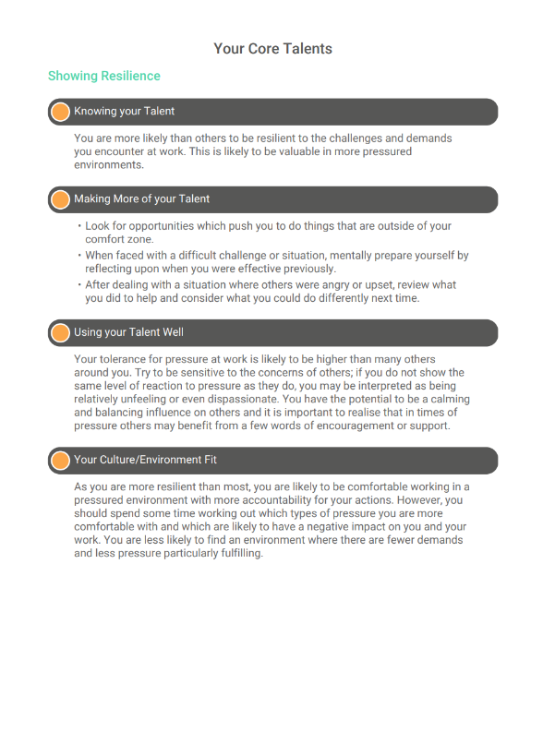

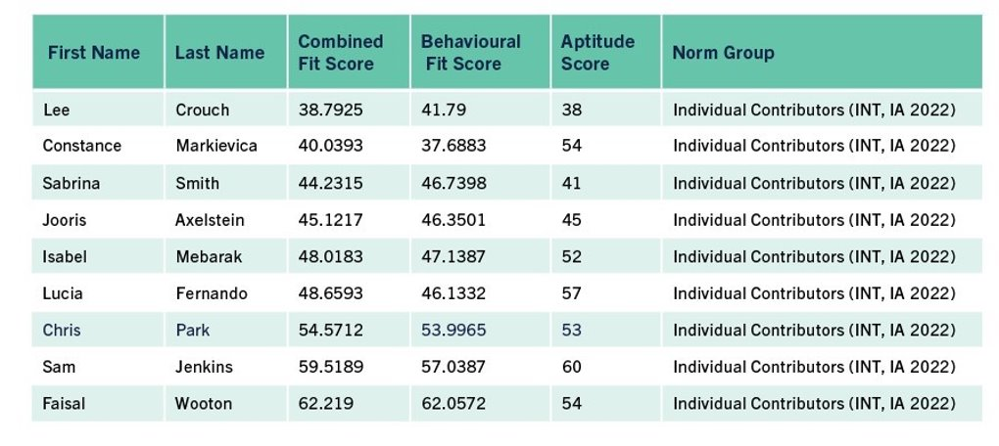
Fit Score
Candidate Feedback
Notes:
These are the candidate feedback reports available from the two screening questionnaires
Match 6.5 candidate report highlights key strengths and challenge areas, also providing tips on making the most of these
Work Strengths culture environment fit report provides an overview of the environments in which this candidate’s performance would be enhanced or inhibited based on their top strengths

Slide 49
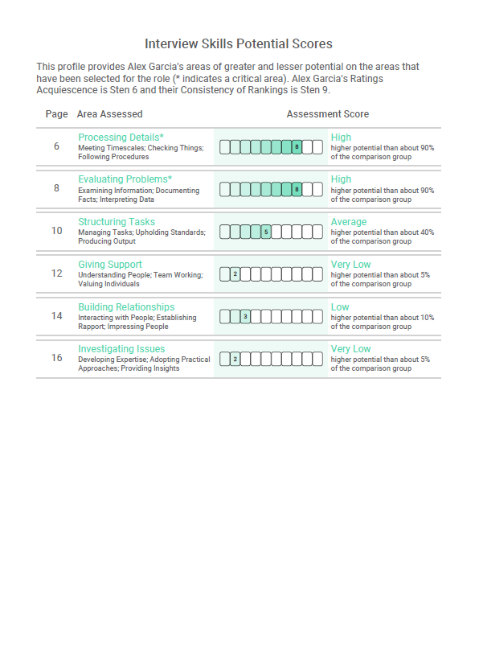

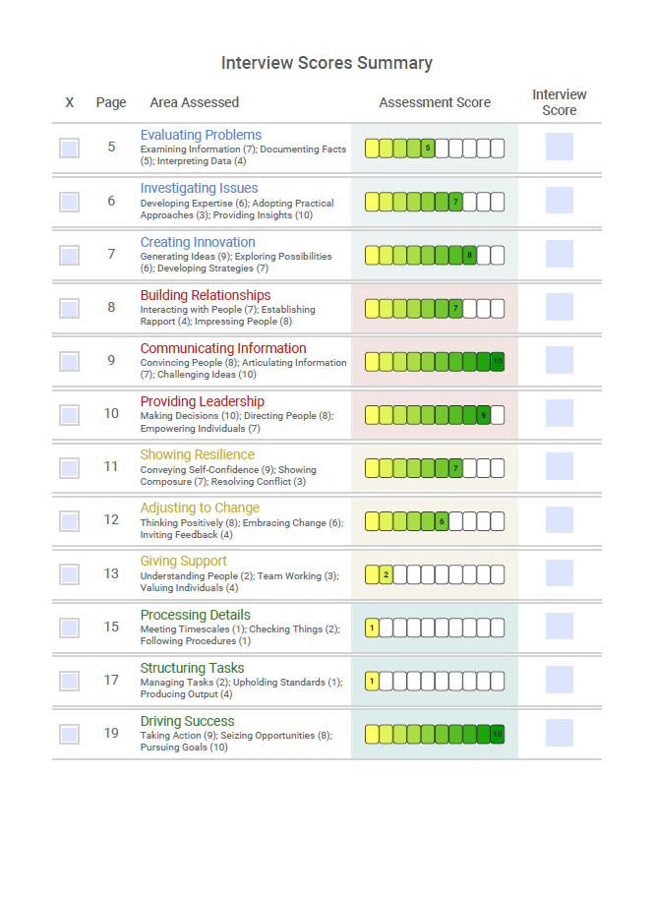
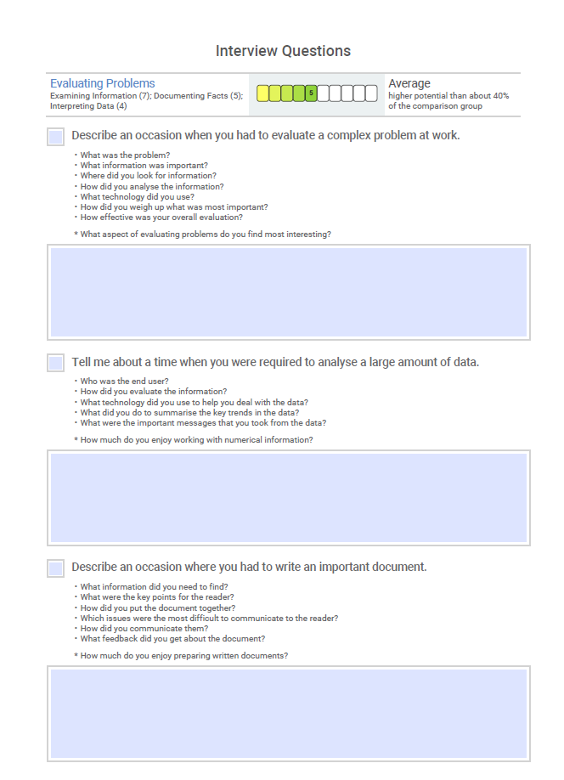


Options for later stage interview
49
Notes:
Interview guides are available from all of our Wave questionnaires
We also have candidate reports
Match 6.5 candidate report highlights key strengths and challenge areas, also providing tips on making the most of these
Work Strengths culture environment fit report provides an overview of the environments in which this candidate’s performance would be enhanced or inhibited based on their top strengths

Slide 50
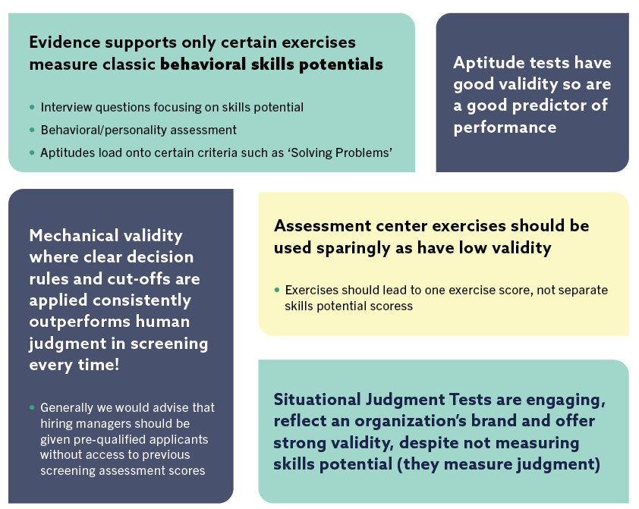
Assessment Choice – Key Points
Notes:
How to manage this part of the course:
Get delegates to complete matrix first, then come together to discuss points on exercises.
AC not linked to competency
Hard to measure comps in exercises.

Slide 51
Administration Format
Unproctored
Proctored
(Invited Access) – This ‘controlled mode’ provides secure access to specific individuals to complete online tests in an unsupervised setting e.g. a password and link are emailed.
This ‘managed mode’ is where a trained administrator verifies and oversees the test environment/process throughout, e.g. at a secure testing center
Security advice for invited access administration:
Ensure candidates are pre-qualified and cannot sit a test multiple times​
Use the advice on test resets documented in your organization’s testing policy​
Use item-banked tests, e.g. gradient step testing​
Review candidate response patterns (‘forensic analysis’), e.g. unusually fast response times​
Retest under proctored conditions
Notes:
Saville Assessment have invited access (IA) assessments for candidates to complete at home.

Slide 52
Overview of Assessment Administration
Key Considerations
Select appropriate tests based on job analysis
Review your organization's testing policy to ensure that your communication and administration are compliant with it.
Prepare your communication (email/letter):
  Explain which test(s) they are being asked to complete and the timing of each
  Explain why the test is used as part of the process
  Check for any reasonable adjustment requirements and any anticipated problems completing the tests
  Ensure candidates have access to preparation/practice materials
  Inform candidates of how you will store their data and for how long, and who will have access to them (i.e. under applicable legislation)
  Inform candidate of next steps, e.g. when they will receive feedback

Slide 53
Module 4
Test Scores

Slide 54
An applicant scores 19 correct (their raw score) on a numerical test (28 items)
How well has the applicant performed?
54
Notes:
Ask trainees to share answers in the chat
We do not know how well the candidate has performed
If everyone scored 25 or above, this person has not performed so well
If everyone scored below 15, this person has performed well

Slide 55
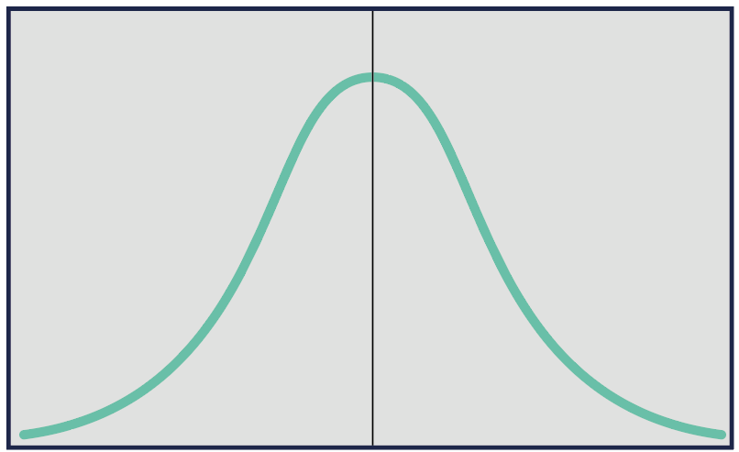
The Normal Distribution
Notes:
Ask trainees if they recognize this curve
Bell curve / normal distribution
Represents most naturally occurring phenomena
If we plot number of people along the side (Y axis) and test scores along the bottom (x axis), we can see that most people achieve the middle scores, with fewer people achieving the very low or very high scores
The same occurs if we look at height; there are very few extremely short or extremely tall people, with most people being classed as average height
Explain how the normal distribution curve can be used to help understand test scores and help get a sense of where you stand compared to others.
Most scores fall around the average (bulge in the middle), with fewer occurrences towards the far left (low scores) and towards the right (high scores).
Most natural phenomena are normally distributed e.g. shoe sizes, height and weight.

Slide 56
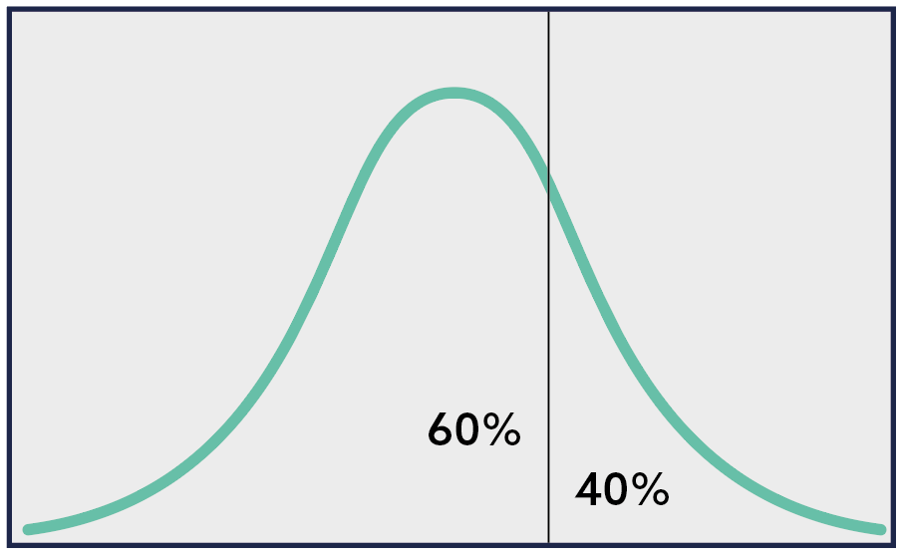
Percentiles
Notes:
One way to cut the normal distribution to start comparing individuals is by using percentiles which is a rank ordering of 1 – 100.
Shows how well someone has performed compared to others, gives us accuracy in exactly where someone sits compared to the population they are being compared against.
A score of 60th %ile means individual performed better than 60% of the comparison group. While 40% performed better. We use positive language when feeding back.
Percentiles allow fine grading and differentiation; however, they are complex and are a wonky ruler because they are not equal units of measurement.
An increase from the 95th to the 99th percentile is a greater performance improvement than an increase from the 50th to the 70th percentile. Percentile scores can therefore be said to reduce the differences at the extremes and exaggerate scores around the middle of the distribution.
Important to note that delegates do not over-read small differences between applicants; one or two raw scores differences near the average can result in a large gap in percentile terms.
If this line represents a candidate’s scores, what does this tell us?
They have performed better than 60% of people (the comparison group)
They have also performed worse than 40% of people, but we always describe percentiles in positive terms
.

Slide 57

Describing Percentiles
Candidate A
Candidate B
Candidate C
56th %ile
33rd %ile
68th %ile
AVERAGE
AVERAGE
AVERAGE
Notes:
When we describe scores, we also use behavioral terms to help explain how to interpret a percentile
The behavioral terms use average bandings; low, below average, average, above average, high
Which of these terms would you use to describe these three percentile scores?
All three of these would be classed as average.

Slide 58
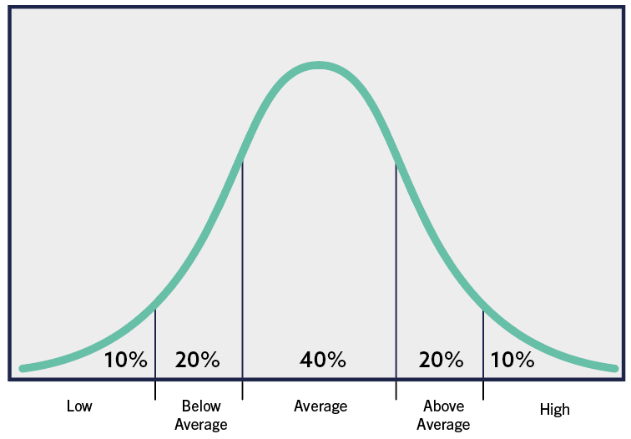
The Normal Distribution Performance Bandings
Notes:
One way to cut the normal distribution to start comparing individuals is by using percentiles which is a rank ordering of 1 – 100.
Shows how well someone has performed compared to others, gives us accuracy in exactly where someone sits compared to the population they are being compared against.
A score of 60th %ile means individual performed better than 60% of the comparison group. While 40% performed better. We use positive language when feeding back.
Percentiles allow fine grading and differentiation; however, they are complex and are a wonky ruler because they are not equal units of measurement.
An increase from the 95th to the 99th percentile is a greater performance improvement than an increase from the 50th to the 70th percentile. Percentile scores can therefore be said to reduce the differences at the extremes and exaggerate scores around the middle of the distribution.
Important to note that delegates do not over-read small differences between applicants; one or two raw scores differences near the average can result in a large gap in percentile terms.
If this line represents a candidate’s scores, what does this tell us?
They have performed better than 60% of people (the comparison group)
They have also performed worse than 40% of people, but we always describe percentiles in positive terms
.

Slide 59
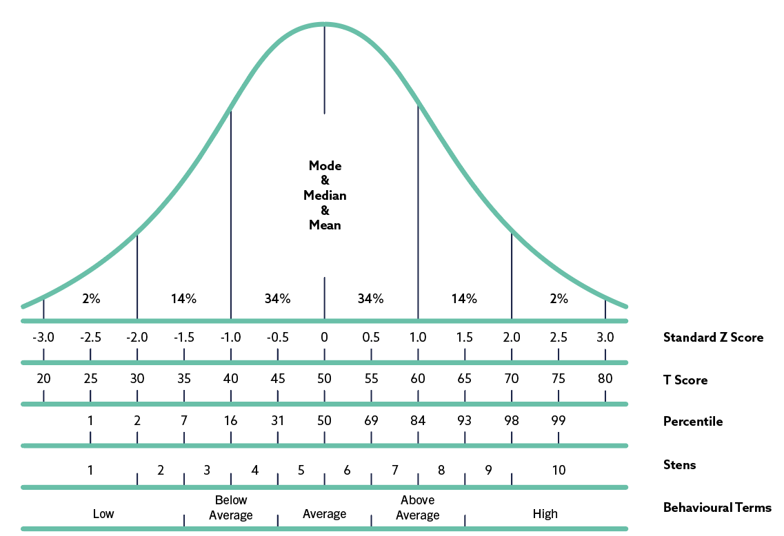
Ways of describing scores

Slide 60
Selecting Test Norms
A representative, relevant sample used to benchmark individuals’ test scores. Norms help us give meaning to a person’s test performance as we can see how they compare to other test takers.
Specific vs general benchmark norms
  Use of specific norms which represent only one protected group, e.g. female only or white only, carries a clear risk of illegal discrimination
Should take account of:
  job applied for
  educational level (required for role, NOT of the candidate)
  work experience (required for role, NOT of the candidate)
  generalisability / representativeness
Suitable size - usually 150+ people
Statistical representation of the population they are drawn from
Individuals who represent real testing situations

Slide 61


Saville Assessment Norms
Levels/Roles
Geographies
Senior Managers and Executives
Professionals and Managers
Individual Contributors
Graduates
Mixed Occupational Group
Apprentices
Technical Occupations
Foundation Level
English as an additional language
International
Regional (e.g. Europe, Africa, Latin America)
Country (e.g. UK, China, Spain)

Slide 62
Case Study Norm Choice
Your Task
Select an appropriate benchmark (norm group) to compare your screening assessments against
Consider why this is the most appropriate benchmark group for your case study process
Assessment | Norm | Target Group
Swift Analysis Range | Senior Managers & Executives | Very senior roles; c-suite
 | Professionals & Managers | Roles in professional settings, may have management responsibilities
 | Graduates | Roles where a degree is required
 | Individual Contributors | Roles in professional settings without management responsibilities
 | Mixed Occupational Group​ | Roles across broad job functions that could be professional or more procedural​
Work Strengths | Professionals & Managers | Roles in professional settings, may have management responsibilities
 | Graduates – All | Roles where a degree is required
 | Graduates – Recent | Roles where a degree is required and fewer than 5 years of work experience
 | Individual Contributors | Roles in professional settings without management responsibilities

Slide 63
Module 5
Test Feedback

Slide 64




Giving feedback
Why do we give feedback?
Public Relations
Candidate experience
Assessor Experience
Applicable Legislation
Notes:
For public relations – candidates are often clients too
To assist in explaining why job offer not made
To increase recruited candidate’s self awareness
To develop individuals in key ability areas
To understand results by seeking examples/explanation
To understand conflicts with other assessment data
To comply with applicable legislation

Slide 65
Feedback of Saville Aptitude Tests
Total score is the main focus in feedback and decision making
Sub-scores help to describe what the test is assessing
Item type or sub-scores also help pinpoint very specific strengths and development needs
Unsupervised online item-banked tests feature information about the combination of an individual’s Pace and Aptitude
Supervised fixed-content tests contain information about an individual’s Speed, Accuracy and Caution
Answer forms and feedback reports give straightforward feedback and development advice for candidates, line managers and trained test users

Slide 66
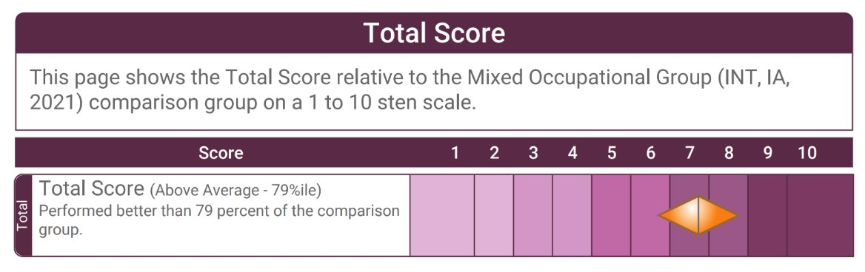
Unproctored Item-banked Profile Example

Slide 67
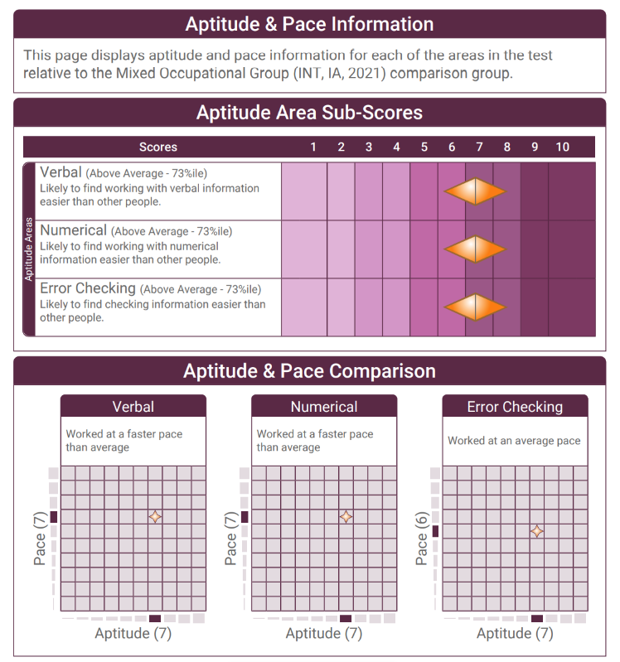
Unproctored Item-banked Profile Example
Notes:
Full report

Slide 68
Feedback process
Introduction
and purpose
Summary of tests used and comparison group
Background
Encourage self assessment
Summary and review
Review pace and sub-scores
Discuss overall performance
Notes:
Aptitude feedback notes are on pg 52 of workbook

Slide 69
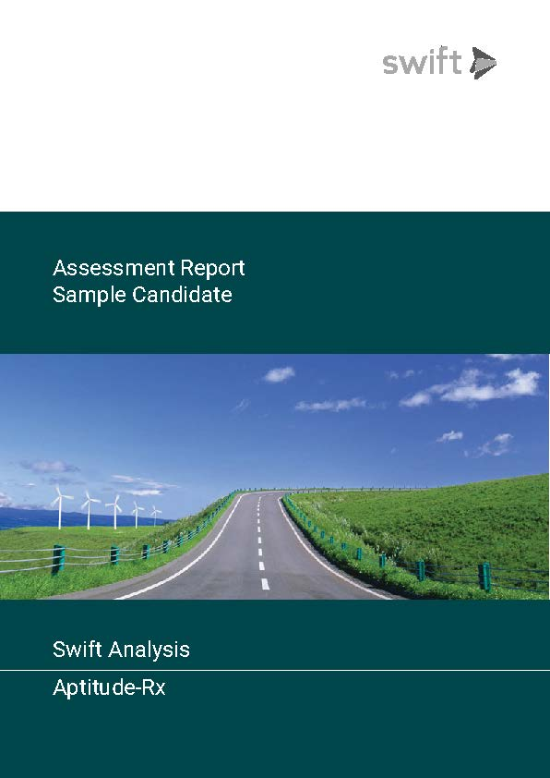

Sample Report

Slide 70



Slide 71




Slide 72
Feedback tips
Most Effective Feedback
Less Effective Feedback
Do build rapport (e.g. give eye contact, ask the delegate how they found the assessments)​
Do ensure two-way dialogue (e.g. invite the candidate to ask any questions throughout and be sure to check their understanding)​
Do gauge candidate reactions and impressions (e.g. ask the candidate whether their scores are in line with their expectations, ask what they think about their performance)​
Do discuss development areas if raised by candidate (e.g. if a candidate has referred to a particular area as a challenge for them, you may want to spend a little more time discussing relevant development tips)
​Giving too much information or too many scores at once can confuse the candidate (i.e. give your candidate time to process the information and space to ask questions)​
Be mindful of using technical jargon (i.e. talking about specific report scores without explaining what they are or what they mean)​
Try not to make value judgments (i.e., “That’s really good…Oh that’s not so great.”)

Slide 73

Practical Session: Feedback
Sample Reports
Aptitude Feedback
  The candidate has been unsuccessful and has requested feedback on their aptitude performance.
  Prepare your feedback session, including an introduction.
  Provide feedback using the sample report provided.
  Use the Aptitude Feedback Guide to help with your preparation
Notes:
Share feedback report
Split into groups / pairs and use sample reports A-D (same as old reports)

Slide 74
Practical Session: Feedback
Sample Reports
Feedback Provider | Report | Candidate
Feedback Provider | Report | Candidate
Notes:
Share feedback report
Split into groups / pairs and use sample reports A-D (same as old reports)

Slide 75
Module 6
Best Practice & Ethics

Slide 76
Best Practice: Key Points
Promote proper data management
Ensure fair assessment
  Test validity
  Preparation materials
  Monitoring differences
Consider the candidate’s needs
Make accommodations for additional requirements
Review your testing policy

Slide 77
Data Implications for Testing
Six principles to ensure that information is handled properly:
1.
2.
3.
Collected for specified, explicit and legitimate purposes and not further processed for an incompatible purpose
Adequate, relevant and limited to what is necessary in relation to the purpose
Processed lawfully, fairly and in a transparent manner
4.
5.
6.
Kept in a form which permits identification of data subjects for no longer than is necessary for the purpose
Accurate and, where necessary, kept up-to-date
Processed in a manner that ensures appropriate security of the personal data

Slide 78
Adverse Impact in Testing
Adverse impact is where a substantially different proportion of one group is hired in comparison to another group
  This is likely to occur where there is a difference between groups in terms of their average test score
As group differences exist, justification for using tests and the level of cut-off matters
  A high cut-off of, for example, the 90th percentile is likely to reduce the relative percentage of Black candidates compared to White or Chinese candidates and it is likely to require strong justification to show that this level of aptitude is required

Slide 79


The Four-Fifths Rule
A selection rate for any protected group which is less than four-fifths (or 80%) of the rate for the group with the highest rate of selection is seen as adverse impact
This affects where we need to set cut-off scores in assessment
Blue group 88% of Green group:
Acceptable Adverse Impact
Blue group 50% of Green group:
Unacceptable Adverse Impact

Slide 80
Setting Cut-Offs
Lower cut-offs are often effectively applied at early screening stages of volume recruitment (e.g. 30th%ile)
  Still need link to job performance (job analysis and/or criterion-related validity)
Higher cut-offs can give even greater return on investment but require more justification (i.e. evidence the job is difficult or that there is strong validity)
  Higher cut-offs can result in lower proportions of potentially disadvantaged groups being selected
  Particular care should be taken when using top-down selection

Slide 81
Best Practice:
Consider the Candidate
Explain the assessment process
Important for procedural justice
Provide practice/preparation material
Establish informed consent
Provide opportunities for right of reply
Promote consistency and fairness for all candidates throughout the process
Test in the most appropriate language (normally first language)
Enquire about additional requirements/accommodations
(e.g. disabilities)
Establish feedback process

Slide 82
Testing Candidates with Additional Requirements
You are responsible for deciding upon an appropriate accommodation/adjustment and will need to:
  Understand the disability
  Seek test publisher advice as to what different accommodation options are available
  Seek expert advice on the candidate’s disability where appropriate
  Decide how to accommodate, test as standard, or not test at all
Typical accommodations include: time adjustment, screen reader technology, large screen/print version, braille, response assistance (sighted reader or person to record responses)
Conversations may be required with the disabled candidate, the assessment provider and even a suitably qualified professional for that disability
Volume testers will generally have policies in place regarding common accommodations, e.g. particular time adjustments for dyslexia upon presentation of an appropriate certificate
A larger band of error should be applied to adjusted test scores

Slide 83
Module 7
Reliability & Validity

Slide 84
Reliability and Validity
Workbook page 59
Reliability
Validity
is about getting the TEST RIGHT – consistent and precise
is about getting the RIGHT TEST – related to its intended purpose
Notes:
Reliability: How consistently and precisely an assessment measures a characteristic.
accuracy and consistency - .7
Validity: Related to the relevance and predictive power of an assessment.
relevance and predictive power - .3

Slide 85
Reliability
Nothing can be measured with absolute accuracy
A test’s reliability concerns the precision and consistency of measurement
The more error in test scores the lower the reliability
Generally, the longer the test the greater the reliability
  NB: Use total scores on Swift tests for decision making
Reliability is a prerequisite for Validity

Slide 86

Potential Sources of Error in Self-Report
Individual
Administrator
Test Developer

Slide 87
Methods of Assessing Reliability
Test-Retest – administering the same test twice
Alternate Form – administering two parallel forms
Internal Consistency – administering only 1 test once
+
Gives indication that attribute is stable
-
Candidates not willing to do it twice
+
Shows developer is clear/consistent on what is measured
-
Has the expense of developing two forms
+
Easy to do as only requires one test on one occasion
-
Can be misleadingly high with repetitive item content
Notes:
Test-retest
- Attribute is stable
- hard to get because candidate might not be willing to do it twice –
- wave .75
Alternate/ Parallel
- two versions of the same assessment are closely related (think of PS and FS)
- clear and consistent in terms of what is measured
- cost of having two versions to compare
- wave .86
Internal consistency
- internal correlations of measures in a questionnaire – how well the questions in one scale are related
If items are repetitive the correlations could look really really high but not actually demonstrate good underlying relationship
- Wave .74

Slide 88
Wave Professional Styles Reliability
Test-Retest Reliability
Dimension mean .75 (range from .58 to .85)
N = 100
Alternate Form Reliability
Dimension mean .86 (range from .78 to .93)
N = 1,153
Internal Consistency Reliability
Dimension mean .74 (range from .58 to .86)
N = 1,153

Slide 89
Aspects of Validity in Self-Report
Workbook page 61
Face Validity: | do the questions ‘look right’ i.e. appear to be appropriate/job-relevant? And do the reports ‘look right’?
Content Validity: | the extent to which the questions are actually focused on job-relevant content.
Consequential Validity: | the intended and unintended consequences of using a questionnaire.
Construct Validity: | different forms of evidence that demonstrates a questionnaire measures the expected underlying construct, trait or theory.
Faith Validity: | an unfounded belief that a questionnaire is appropriate, i.e. in the absence of evidence.
Criterion-related Validity: | evidence that the questionnaire predicts relevant criteria (e.g. skills potential).
Notes:
Face and Faith
Content: Focusing on relevant content (i.e. job and work-related)
Construct: Measures expected underlying value such as a trait or theory
(for example a beahvioural measure aimed at building relationships shouldn’t be more focused on anything else)
Consequential: consequences of using the assessment – do no harm, appropriate for promotion decision, etc.
Criterion: - does the questionnaire predict a particular criterion? E.g. job competency

Slide 90
The Wave Model: Validity
Performance Driven
Dynamic Rating Format
Questions were selected on the basis of how well each facet (motive and talent) correlated with overall performance and potential.
By enabling a dual dynamic rating format (‘ra-ra’) it is possible to further improve the validity.
Predictive Skills Potential
Project Epsom
Skills Potential and self-report questions which were less correlated with overall performance were dropped.
A large sample of participants (N=308) validated the Wave model, alongside other popular personality questionnaires.
Notes:
Designed with validity in mind, from the start – items written and selected to predict overall working performance
Rate/Rank – helps minimise distortion – makes profiles more reflective of people’s typical behaviour
Only the most predictive competencies were kept, those giving less prediction about performance were less useful so we didn’t keep them in
Epsom – looking at constructs of existing assessments – more information in your workbooks

Slide 91

Validity of Different Selection Techniques
Notes:
Based on our own data as well as meta-analyses
When you are building a selection process/ ac make sure you’re using the methods which will give you most value – what’s going to be giving the information you really need?

Slide 92

The Wave Model
Validity
Notes:
Anything over .3 is giving good prediction about performance, so all of these tools are good

Slide 93


Validity? So What?
0 Validity – 1 person in 5 will be a poor performer
Questionnaires with the highest validity increase the chance of selecting the best performers at work and considerably reduce selection errors
Moving from recruiting using a questionnaire with a validity of +0.3 to using a questionnaire with a validity of +0.6 can double the cost benefit to an organization
      This can also reduce the number of serious selection errors five-fold
0.3 Validity – 1 person in 10 will be a poor performer
0.6 Validity – 1 person in 50 will be a poor performer
Notes:
Page 63
The greater your validity, the greater the benefit to the organization as you get more test utility or return on investment.
The greater your validity, the smaller the risk of a wrong hire, the more accurate your selection process is of hiring the right person - so the return on investment is massive

Slide 94

Return on Investment
Saville Assessment ROI Model
Notes:
Our ROI model – using rigorous, robust assessment means you’re giving candidates a Quality experience and helping engagement whilst getting what you need from the selection methods too. You can reliability screen out less suitable candidates and select in those who will support the organisation best.
Consider the cost of a poor hire, needing to go out to recruit again, administrator time and resource
Standarised, objective, less room for subjectivity and bias which could unfairly impact different groups – genders, ages, ethnicities, etc.

Slide 95
Next Steps

Slide 96

Next steps
Contact our Duty Consultant for additional support
Call: +44 (0)208 619 9000 Email: expert@savilleassessment.com

Slide 97


Administering Tests: A Recap
No annual subscription fees to use tests
No separate administration, scoring or profiling fees
Administering via the Bureau
Complete a form – our Bureau team do the rest
Cost-effective for small numbers
Fast turnaround within two hours
Open 8am – 6pm UK time
Administering Using Oasys
One-off investment
Free training to use Oasys
Better value for larger numbers
You are in control of your own projects
Can be branded or non-branded
99.9% uptime
Notes:
Look at current price list for notes around pricing

Slide 98




The Saville Assessment Community
What you can expect:
Support from our duty consultant, bureau team and account managers
Opportunities for continued professional development
Invitations to webinars and practitioner masterclasses
Discussion on industry-specific news and topics
Networking opportunities with other professionals, including our series of Wave User Groups
Privileged offers
Access to our Client Resource Area
@savilleassess
@savilleassess
https://www.linkedin.com/company
/saville-assessment
www.facebook.com/SavilleAssess/

