Slide 1
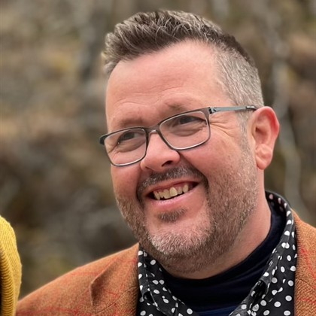

Skills: everyone’s talking about them, but are they having the right conversation?
Rab MacIver
Cpsychol, MSc, BSc

Slide 2
A Look Back in History
focus on strengths
(rather than remedial development model)
shift to competencies
shift to skills
biographical interviews
Pre 1980s
1980s
2010s
2020s

Slide 3
Skills Language
Skills gaps
Skills-based organisations
Reskill
Skills development
Upskill
Skills framework
Skilled
Skills-based hiring
Skills resonate with people at all levels in a way that competencies never did

Slide 4
Why Skills Matter?
Unleashing potential with a systematic model for HR and our talent solutions
Recruit
Retain
Reskill
Redesign
75% of candidates will research a company’s reputation before applying for a job opening¹
A lack of employee development opportunities is the #1 reason an employee chooses to leave the company²
74% of workers are likely to leave a job due to lack of skill development³
Jobs and careers will be redefined by the convergence of industries⁴
* Strategic sourcing
* Diverse hiring
* Candidate experience
* Employment brand
* University relationships
* Recruiter skills
* Recruiting operations⁴
* Employee experience
* Culture
* Benefits, childcare
* Flexibility, 4-day workweek
* Pay equity
* Human-centered leadership
* Listening and analytics⁴
* Career pathways
* Skills taxonomy
* Skills programs
* Adjacent roles
* Adjacent skills
* Talent mobility
* Talent marketplace⁴
* Work analysis
* Job design
* Employment model
* Gig, contract work
* Outsourcing
* Automation
* Productivity platforms⁴
Source: LinkedIn
Source: CultureAmp
Upskilling Study - Workplace Intelligence
Josh Bersin, HR Predictions for 2023 Report
Josh Bersin’s 4-R Systematic Model for HR
Notes:
Over half of Gen Zs and millennials say they research a brand’s environmental impact and policies before accepting a job offer
Companies that focus on growth are 29 times more likely to let employees “unleash their potential,” 4 times more likely to be innovation leaders, and 7.2 times more likely to be best places to work (Bersin)

Slide 5

Competency-Driven Predictive Model
Culture, Job & Environment
Overall Performance
Motives
Competency
Potential
STYLES
Talents
Demonstrating Potential
Accomplishing Objectives
Applying Specialist Expertise
Powered by Wave Assessment

Slide 6
Shift from Competencies to Skills
Wave Competency Potential scores do not indicate skill level
Skills – refer to the ability to perform tasks effectively
  These abilities are often acquired through practice, training, or experience
‘Skills Potential’ – refers to the attributes (behavioural style and preferences) that predispose you to develop and utilize the skills effectively in a professional context
  Different combinations of skills potential attributes will link to different skills
  Can develop the skill faster, to a higher level and with less learning effort
To develop the skill you still have to learn
Optimal way to learn depends on the skill and your learning approach/personality

Slide 7
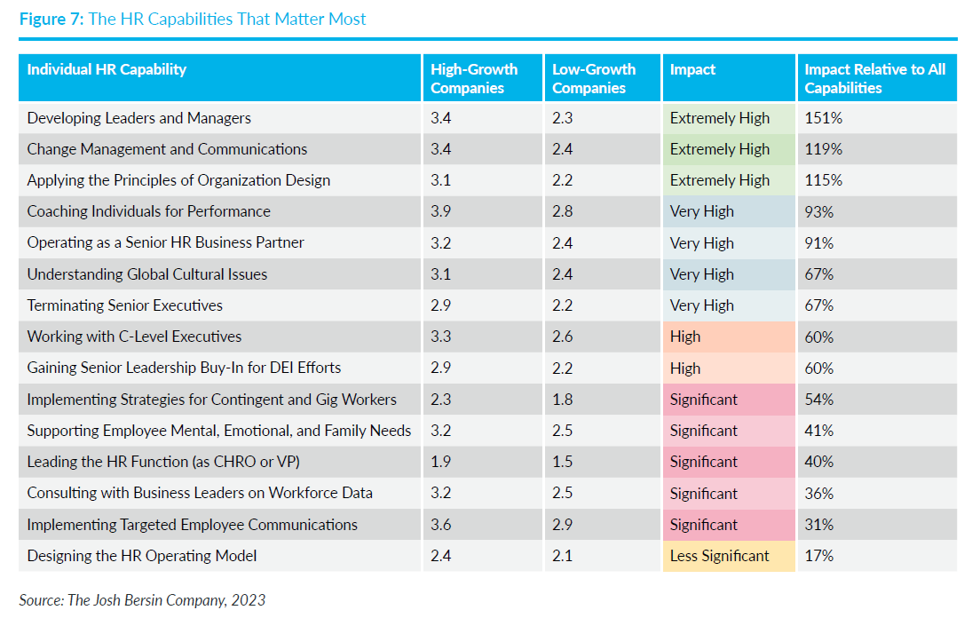
The HR Capabilities that Matter Most
Source: Josh Bersin’s Enterprise Talent Intelligence Report

Slide 8



Future Skills
Impact on Leadership
Workforce Challenge¹
Inhibitor to progress¹
New Models²
Identifying skills of the future and communicating impacts automation and AI will have on these.
Leadership capability
Every company will need to revisit its leadership model
Future of Work and Skills (pwc.com)
Josh Bersin, HR Predictions for 2023 Report
Notes:
Most significant workforce challenges cited by leaders³
Identifying the skills workers will need in the future due to technology
Communicating clearly about the effect of automation and AI on future skills needs
Most significant inhibitors to progress
Cost pressures
Leadership capability
Organisational culture
Therefore, fairness analysis was also run using over 18,000 international
professionals and managers. Where potential adverse impact was identified,
the equation was further refined to increase fairness. Specifically, initial
versions of the equation were slightly favoring men, so certain behaviors
which tended to be higher in males were de-prioritized and behaviors
which tended to be higher in females were brought in or weighted higher
to even this out. The initial assumption was that this would slightly reduce
the validity of the equation – an acceptable trade-off to increase fairness.
We were delighted to discover that not only did the validity not drop but it
actually increased slightly. We were fascinated by the implication that more
supportive behaviors such as understanding and getting to know people
could increase potential for leadership roles when combined with more
typical leadership behaviors around drive and leading people, rather than
detract from them
We were fascinated by the implication that
more supportive
behaviors such
as understanding
and getting to
know people could
increase potential
for leadership roles
when combined
with more typical
leadership
behaviors around
drive and leading
people, rather than
detract from them.
Improtance of leaders to build trust

Slide 9

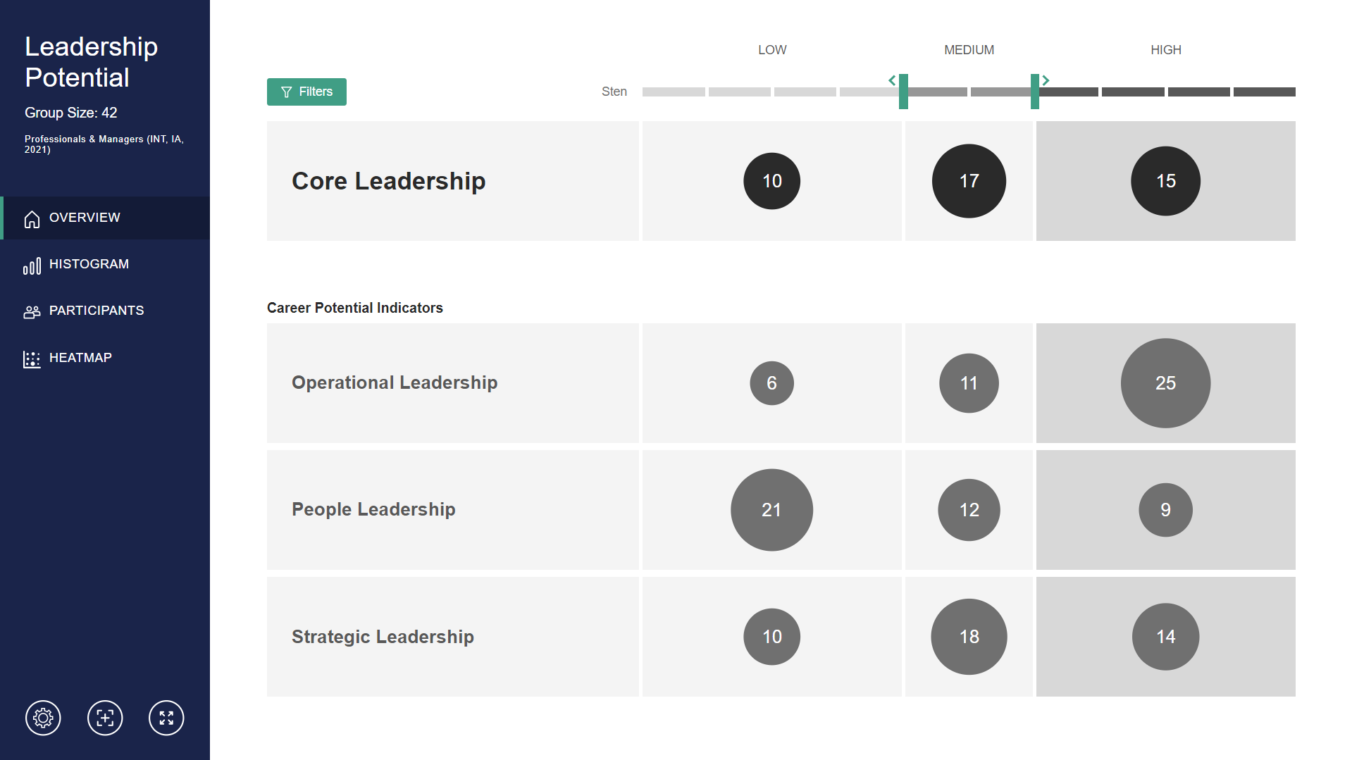
The landscape of work is changing and so are the types of leaders we need
Our Wave Leadership Potential Research
More supportive behaviors increased potential for leadership roles and fairness when combined with more typical leadership behaviors around drive and leading people, rather than detract from them.
Notes:
Therefore, fairness analysis was also run using over 18,000 international
professionals and managers. Where potential adverse impact was identified,
the equation was further refined to increase fairness. Specifically, initial
versions of the equation were slightly favoring men, so certain behaviors
which tended to be higher in males were de-prioritized and behaviors
which tended to be higher in females were brought in or weighted higher
to even this out. The initial assumption was that this would slightly reduce
the validity of the equation – an acceptable trade-off to increase fairness.
We were delighted to discover that not only did the validity not drop but it
actually increased slightly. We were fascinated by the implication that more
supportive behaviors such as understanding and getting to know people
could increase potential for leadership roles when combined with more
typical leadership behaviors around drive and leading people, rather than
detract from them
We were fascinated by the implication that more supportive behaviors such as understanding and getting to know people could increase potential
for leadership roles when combined with more typical leadership behaviors around drive and leading people, rather than detract from them.
Improtance of leaders to build trust

Slide 10
Increased Need to Reskill & Upskill
85% of organisations are increasing adoption of new technology¹
66% of large businesses said they would struggle to recruit employees with the skills they need²
Six in 10 workers will require training before 2027 but only half have access to training opportunities¹
The World Economic Forum’s Future of Jobs 2023 report
Oxford Learning College, 2022
Notes:
The cost of losing talent is expensive, and this is more likely to happen in times of transformation, due to uncertainty. For example, change in direction, job security, leadership changes, increased workload, lack of communication etc., - all situations that can arise from technological advancements.
For more than a year now, organizations have struggled to hold onto talent. According to the U.S. Bureau of Labor Statistics, 4.2 million people voluntarily quit their jobs in August 2022. At the same time, there were 10.1 million job openings. Between the Great Resignation and more recent trends like “quiet quitting,” traditional approaches for winning talented workers haven’t always cut it in this fiercely competitive market.
This might be areas such as, digital upskilling, leadership, technical product knowledge, analytics.
At Saville we supported Rioch to identify internal talent suitable developing digital skills. This allows you to make data-led decisions on how to manage and upskill the preexisting talent within your organisation.
Not being limited to industry / demographic specific talent to support with current and future requirements of the workforce.
“There is a massive effort to build skills models and assess skills, as well as for improved internal mobility, talent marketplaces, and new ways of nurturing high-value talent from currently low-status employees.” Traditional career pathways may no longer be valid, nor will “recruiting on experience” as jobs will change all the time. Because the formal relationship between person and job is getting weaker, people will work across multiple roles and projects and skills needs will shift rapidly. To respond to this, HR will need to move away from competency-based models of hiring and promotion and use data to focus on who has the right skills for any project or role. This should be “capabilities first, skills second”, he suggests. – Josh Bersin
Six in 10 workers will require training before 2027, but only half of workers are seen to have access to adequate training opportunities today. The highest priority for skills training from 2023-2027 is analytical thinking, which is set to account for 10% of training initiatives, on average. The second priority for workforce development is to promote creative thinking, which will be the subject of 8% of upskilling initiatives. Training workers to utilize AI and big data ranks third among company skills-training priorities in the next five years and will be prioritized by 42% of surveyed companies. Employers also plan to focus on developing worker’s skills in leadership and social influence (40% of companies); resilience, flexibility and agility (32%); and curiosity and lifelong learning (30%). Two-thirds of companies expect to see a return on investment on skills training within a year of the investment, whether in the form of enhanced cross-role mobility, increased worker satisfaction or enhanced worker productivity. The skills that companies report to be increasing in importance the fastest are not always reflected in corporate upskilling strategies.
In response 48% of companies identify improving talent progression and promotion processes as a key business practice that can increase the availability of talent to their organization, ahead of offering higher wages (36%) and offering effective reskilling and upskilling (34%). – organisations concerns are skills gaps and inability to attract talent.
With a reskilling program, you can develop the skills you’re struggling to find on the market internally instead. Your existing employees already have institutional knowledge and transferable skills that make them ideal candidates for open positions within the company. – Aon
More than 75% of companies are looking to adopt tech such as, AI and cloud computing. Agriculture technologies, digital platforms and apps, e-commerce and digital trade, and AI are all expected to result in significant labour-market disruption, with substantial proportions of companies forecasting job displacement in their organizations, offset by job growth elsewhere to result in a net positive. – World Economic Forum. Organizations today estimate that 34% of all business-related tasks are performed by machines, with the remaining 66% performed by humans.
The largest losses are expected in administrative roles and in traditional security, factory and commerce roles. - what does this mean in terms of the factories being built in Mexico?
https://www.oxfordcollege.ac/news/skills-gap-statistics-uk/#:~:text=One%20report%20from%202022%20found,for%20leisure%20and%20hospitality%20companies.
https://www.valamis.com/hub/upskilling?_gl=1*1lrzhl*_up*MQ..*_ga*NjAyMDA4MzE1LjE2OTQ3ODY1MzU.*_ga_WH32P1Y0T3*MTY5NDc4NjUzNC4xLjAuMTY5NDc4NjUzNC4wLjAuMA..#benefits-of-upskilling – good info graphic
https://assessment.aon.com/en-us/blog/overcome-skill-shortages-by-increasing-talent-pools
https://cappfinity.com/cappfinity-unveils-three-new-leadership-talent-solutions/
The shift in skill needs was already a challenge, but more than 58% of workforces report skill transformations since the onset of the pandemic. – Udemy
**Reflection:
Whilst we focus on developing the skills required, we also need to consider and manage the impact that comes with change in organisations. With transformation comes uncertainty, and uncertainty can have negative consequences on employee engagement and in worse cases, increase voluntary attrition (Culture Amp, Deloitte).
Jobs are set to change in line with digital growth, and people will be expected to work across multiple roles and projects, and "every company will need to revist its leadership model" (Josh Bersin, HR Predictions Report, 2023).
Upskilling workers in leadership is reported to be a particular priority in many industries1
Identify skill gaps and understand the potential of your internal talent pool. A focus on skills development and employee experience can help to close the skills gap

Slide 11
The Science of Skills
Powered by Wave Assessment
Motives
STYLES
SKILLS POTENTIAL
Talents
Overall Performance
Styles identifies which Learning Methods are Easy Wins or Hard Fought
Learning Methods
Formal
Experiential
Demonstrating Potential
Accomplishing Objectives
Applying Specialist Expertise
Social
Culture, Job & Environment
Reading/Podcasts
Tuition
Training/Education
Coaching
Mentoring
Peer to Peer
Experience/Practise
Feedback
Observation
SKILLS

Slide 12
Move from Experience to Skills Potential
Diversity
Opportunity and privilege
Social mobility
Neurodiversity
Education
Experience
Competencies
Skills
SKILLS POTENTIAL
Gender
Ethnicity

Slide 13
Skills and the Future of HR
 | Hire | Develop | Perform
Function | Talent acquisition | Talent development | Talent management
Data & Technology | ATSs | LMSs | Performance management systems
 | Skills and Skills Potential Framework
Function | Systemic HR
Data | Single data lake
Technology | Integrated system across Hire/Develop/Perform

Slide 14
Lessons and Pitfalls from Our Review
Skills resonate and are here to stay
Skills potential underpins fairer hiring and more targeted skills development
Inconsistency in how skills are defined
  Some are very broad
  Some are very narrow
  Some are NOT skills (other attributes – personality, attitudinal, emotional states, etc.)
Skills should be about mastery
Skills frameworks should NOT be levelled (e.g. Professional/Manager/Senior Manager)
Skills should be highly specific and more granular than competencies

Slide 15


Skills Potential and Skills
Plant a tree or play an instrument?

Slide 16
“Build your skills not your resume.”
– Sheryl Sandberg
“Most skills can be learned, but it is difficult
to train people on their personality.”
– Richard Branson
“Talent you have naturally; skill is only
developed by hours and hours of work.”
– Usain Bolt

